Slide 1
Dave Schimel, JPL
Ben Poulter, GSFC
Co-leads
SBG Research and Applications Support for Architecture

Slide 2
Mission Study on Surface Biology and Geology
SBG Science: Objectives from 5 Focus Areas
Variability of the land surface and the fluxes of water, energy and momentum
Flows of energy, carbon, water, and nutrients sustaining the life cycle of terrestrial and marine ecosystems
Composition and temperature of volcanic products immediately following eruptions
Snow accumulation and melt
Inventory the world’s volcanos
The global carbon cycle and associated climate and ecosystem impacts
Monthly terrestrial CO₂ fluxes at 100 km scale
Land and water use effects on evapotranspiration
Functional traits and diversity of terrestrial and aquatic vegetation
Water balance from headwaters to the continent

Slide 3
The Research & Applications Team developed science traceability for the study and also fills other critical roles, as below
RA Steering Committee
Dave Schimel and Ben Poulter, co-leads
Liane Guild, ARC, Jeff Luvall, MSFC, David Thompson, JPL, Rob Green, JPL, Simon Hook, JPL + Working Group Co-Leads
Algorithm WG
Phil Townsend & Kerry Cawse-Nicholson
Cal/Val WG
Kevin Turpie & Ray Kokaly
Applications WG
Jeff Luvall, Christine Lee, Stephanie Uz
Modeling WG
Ben Poulter, Weile Wang, Shawn Serbin
~400 members overall

Slide 4
COMMUNITY ENGAGEMENT
2018 | Q1 | ◂SBG Town Hall Ocean Science Meeting 2018 (Portland, OR USA)
 | Q2
 | Q3 | ◂1st SBG/Final HyspIRI Community Workshop
 | Q4 | ◂Ocean Optics SBG Town Hall (October - Dubrovnik, Croatia) R&A Team Working Groups Formed (December) Regular, open WG telecons begin (weekly-biweekly)
2019 | Q1 | SATM released publicly RF+I released for broad input
 | Q2 | ◂2nd SBG Community Workshop (June), 125 on site, ~30-40 webex
 | Q3
 | Q4 | ◂SBG Session at AGU Annual Meeting (San Francisco, CA USA)

Slide 5
COMMUNITY ENGAGEMENT
You Are Here
2020 | Q1 | ◂SBG Town Hall at OSM 2020 (San Diego, CA USA)
 | Q2 | Community architecture telecons (April-May)
 | Q3 | Architecture down-select complete, Phase 3 begins (July) Community telecon on recommended architecture (July)
 | Q4 | ◂SBG Town Hall at Ocean Optics (Norfolk, VA USA) (October) ◂SBG Town Hall at AGU Annual Meeting (San Francisco, CA USA) (December)
2021 | Q1
 | Q2 | ◂4th SBG Community Workshop (TBD) (June)
 | Q3 | Mission Concept Review (October)
 | Q4

Slide 6
The need of the science are captured in the Science and Applications traceability matrix

Slide 7
Overarching Needs of the SBG Observing System from DS Science Priorities E-1 – E-3, S1, S2, H-1, H-2, W-3 and C-3
Global coverage to address the explicit global scope of the science, and the need to address the impacts on the Earth System and not just local processes, this means that the portion of terrestrial land and the coastal zone that can drive the earth system through the carbon and water cycles should be observed. 85 degrees N-S addresses this.
High spatial resolution to identify regional scales as called for in other objectives, pixels between 20 and 60 m (60-100 m for TIR) satisfy this.
Sufficient mission duration to observe change, alternately a strategy for continuity of identified key measurements so that SBG is synergistic with other US and international programs. 3-7 years with possibility of continuity satisfies this.
Spectroscopic and thermal measurements of sufficiently high quality to resolve trace constituents and phenomena in terrestrial, aquatic, geological and atmospheric media.
Temporal resolution to quantify the frequency of Earth System events assigned to SBG as well as to observe rapid or transient changes. Revist of the global area covered (eg, between 85 N-S) between 1 and 16 days satisfies this and may vary for VSWIR and TIR. This should be accompanied by latency low enough to address S-1 and S-2 and possibly other objectives and priorities. In a related parameter, Latency should address a minimum of 25% of identified application uses.
The Architecture Study may consider components that address subsets but must be combined in systems that address 1-5.

Slide 8
SATM Capability Classes Guide Architectures
SATM Capability Classes
 | VSWIR Spatial | VSWIR Temporal | VSWIR Range | VSWIR Sensitivity | TIR Spatial | TIR Temporal | TIR Range | TIR Sensitivity | VSWIR/TIR Coincidence
Capability
Class
≤30 m | ≤8 days for global coverage* | ≤380 - ≥2500 nm, @ ≤10nm | SNR ≥400 VNIR, SNR ≥250 SWIR, accuracy ≤10% | ≤60 m | ≤1 day for global coverage* | ≥5 bands in 8-12 um, ≥ 1 band in 3 -4.5 um | ≤1K Absolue, ≤0.2K NeDT / band | Simultaneous within 30 seconds
≤60 m | ≤16 days for global coverage* | ≤380 nm - ≥1000 nm, @ ≤10nm | ≤10% Absolute accuracy | 60-100 m | ≤3 days for global coverage* | ≥5 bands in 8-12 um | ≤1.5% Absolute, <1K NeDT / band | On same day
 |  | VNIR multiband |  | ≤100 m | ≤5 days for global coverage* | ≥3 bands in 8-12 um |  | VNIR within 3 days
A
B
C

Slide 9
Measurement consensus
VSWIR |  |  |  | TIR
Spatial | Revisit | Range | Sensitivity | Spatial | Revisit | Range | Sensitivity
94% A | 54% B | 76% A | 64% A | 77% A | 46% B | 46% B | 54% na (46% A)
Distance from ABAA ABBA is used to rank science value, note credit giving for exceeding the metric.

Slide 10
Measurement objective consensus provided to Architecture team as a goal
Wall-to-wall global coverage is essential for R&A
ABAA ABBA is measurement target, selected architecture exceed this level. *
Maximum measurement performance a goal, cannot be traded against revisit/resolution. *
Specific R&A objectives add additional detailed specs, to be addressed. *
Revisit can be enhanced by international collaboration, moderate resolution fusion and suborbital elements.
Applications depend significantly on revisit and data latency: fast turn-around a priority. *
Many measurement details will be addressed in design and Phase A, guided by the above.
* Community input significantly added to, or modified initial Decadal Survey objectives.

Slide 11
Dave Bearden, SBG Phase 2 Lead (JPL)
Jon Chrone, SBG Phase 2 Deputy (LaRC)
Surface Biology and Geology
Architecture Assessment

Slide 12
Architecture Evaluation Objectives
Identify architectures to support most important and very important science objectives
Develop Value Framework to evaluate architecture solutions to most/very important science and applications objectives performance, risk, cost, schedule
Assess a diverse set of high value SBG observing architectures and reduce down to a few promising architectures
Provide justification for eliminating candidate architectures

Slide 13
SBG Architecture Concept Flow to Initial Value Assessment
Define Arch. Elements
Choose Instruments
Instrument Capability
Size Systems
number, type
Use capability levels (A, B, C) as outlined in the SATM
Estimate Cost
Multiple capabilities within an architecture family
Instrument – parametrics
Spacecraft – S/M/L heuristics
Percentage wraps for other elements
Launch – table of options
Map to Decadal Priorities
Smallsat, constellations
Combinations, etc.
TIR, VSWIR
Objectives met by system: MI/VI/I
Plot Value vs. Cost
Compare with threshold (80%) and baseline (100%)
Include partnerships
Select launch vehicle
Flagship, Largesat, Mediumsats
Parametrics to estimate mass, power
Non-space elements
Assess performance: resolution, SNR, revisit, etc.
Number of Platforms & Orbits
Assess Value
Place highest value on most important objectives
Include credit for applications
Parameters: Spatial, Temporal, Spectral Range & Sensitivity
1. Architecture Definition
2. Value - Effectiveness
3. Cost Effectiveness - Comparisons
Pre-decisional - For Discussion Purposes Only

Slide 14
1. Define Architectures and Capabilities
Options for Space-based Systems
Observing System Class
Launch Vehicle
# Platforms
Instrument Configuration
Calibration
Data Latency
Mission Duration
Flagship
Falcon-9 or Vulcan
1
VNIR
0.4 – 1.0 μm
OnBoard
High
3 yrs
Large-Class
Electron or Virgin
2
VSWIR
0.4 – 1.7 μm
Vicarious
Medium
5-7 yrs
Medium-Class
Secondary
Multiple
VSWIR
0.4 – 2.5 μm
Low
Small-Class
Vega or PSLV
TIR
Whisk-Push
Additional Features
Constellation
TIR
PushBroom
Off-nadir Pointing
International Contributions
Micro
bolometer
5 Classes
60 Variants
765 permutations
Flight Spares
Airborne Component
TIR
Hyperspectral
MOps Coordination
OnBoard Processing
Non-SBG instruments
Hosted Payloiad

Slide 15
Example - SmallSat Class Options
16 variants; 324 possible permutations
Observing System Class
Launch Vehicle
# Platforms
Instrument Configuration
Calibration
Data Latency
Mission Duration
Flagship
Falcon-9 or Vulcan
1
VNIR
0.4 – 1.0 μm
OnBoard
High
3 yrs
Large-Class
Electron or Virgin
2
VSWIR
0.4 – 1.7 μm
Vicarious
Medium
5-7 yrs
Medium-Class
Secondary
Multiple
VSWIR
0.4 – 2.5 μm
Low
Small-Class
Vega or PSLV
TIR
Whisk-Push
Additional Features
Constellation
TIR
PushBroom
Off-nadir Pointing
International Contributions
TIR
Bolometer
VSWIR Vicarious Calibration only
Mission duration only guaranteed to 3 yrs
International Coordination with ESA and/or ASI and/or ISRO
TIR
Camera
Flight Spares
Airborne Component
Non-SBG instruments
MOps Coordination
OnBoard Processing

Slide 16
2. Value Effectiveness at Meeting Decadal Objectives
Capability Code | VSWIR |  |  |  | TIR
 | Spatial | Temporal | Range | Sensitivity | Spatial | Temporal | Range | Sensitivity | VSWIR/TIR Coincidence
A | ≤30 m | ≤8 days for global coverage* | ≤380 - ≥2500 nm, @ ≤10nm | SNR ≥400 VNIR, SNR ≥250 SWIR, accuracy ≤10% | ≤30 m | ≤1 day for global coverage* | ≥5 bands in 8-12 um, ≥ 1 band in 3 -4.5 um | ≤1K Absolue, ≤0.2K NeDT / band | Simultaneous within 30 seconds
B | ≤60 m | ≤16 days for global coverage* | ≤380 nm - ≥1000 nm, @ ≤10nm | ≤10% Absolute accuracy | ≤60 m | ≤3 days for global coverage* | ≥5 bands in 8-12 um | ≤1.5% Absolute, <1K NeDT / band | On same day
C |  |  | VNIR multiband |  | ≤100 m | ≤5 days for global coverage* | ≥3 bands in 8-12 um |  | VNIR within 3 days

Slide 17
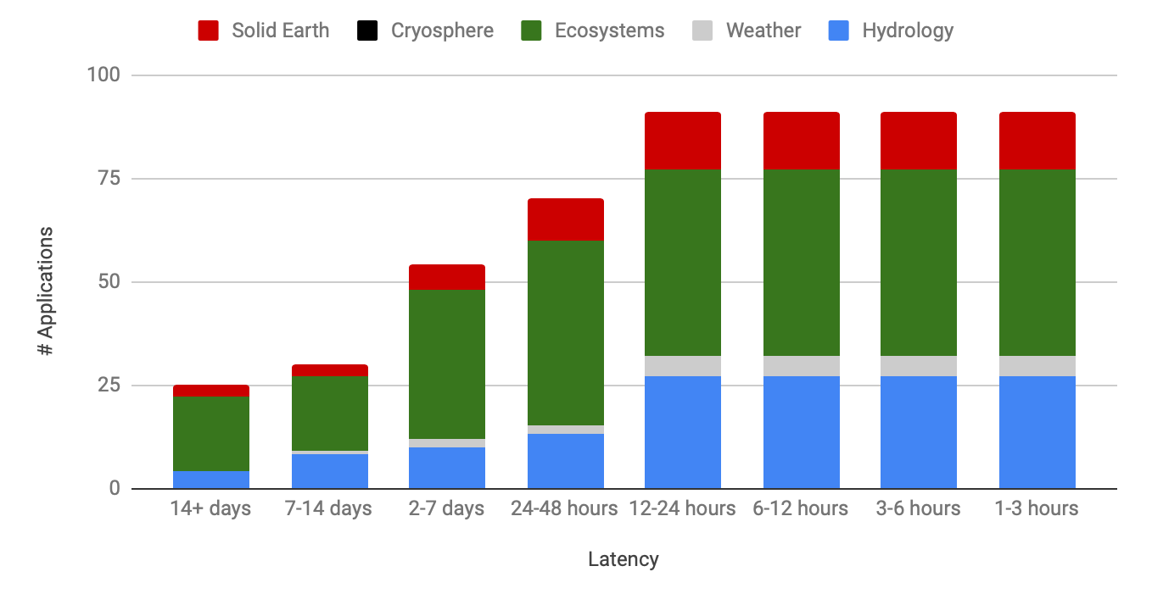
Applications Value: 12-24 hour latency* enables 100% of currently identified applications
* Latency = time from acquisition to data access
Analysis resulted in Applications-related latency in the SATM
This is an example of a result we can use to assess science and applications value across multiple architectures
The Community Assessment Report will expand on this
Pre-decisional - For Discussion Purposes Only

Slide 18
3. Cost Effectiveness Comparisons
Reduced cost may be enabled through strategic partnerships or commercial opportunities.
Enhanced science return may be enabled through new technologies and/or innovation.
Architectures below the Threshold or significantly above cost target will not be considered.
Cost Target
Enhanced science within Budget
Exceeds other priorities
Reduced cost enabled via partnerships
Baseline Objective
Low-cost that meets Threshold
Value
Threshold Objective
Below Threshold Criteria
Science Cost

Slide 19
Value Framework Overview
SBG Value Framework assesses key features relevant to decision criteria while providing the ability to discriminate between alternatives
Quantitative features
Capability (Science & Applications)
Cost / Affordability
Schedule
Risk
Qualitative features
Programmatic factors
International Partnerships

Slide 20
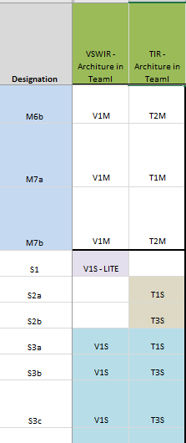
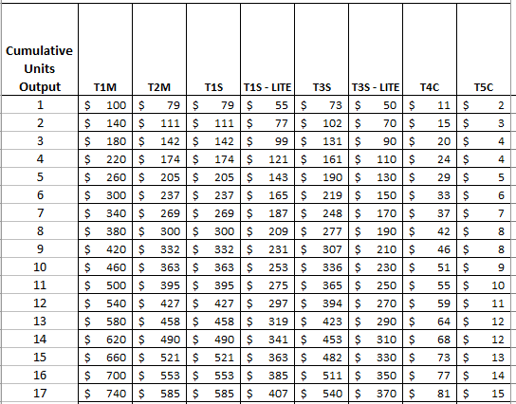
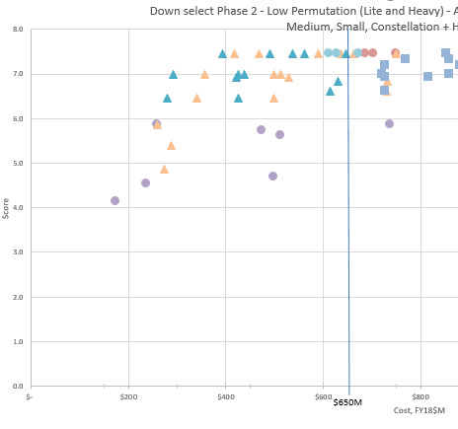
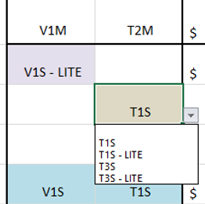
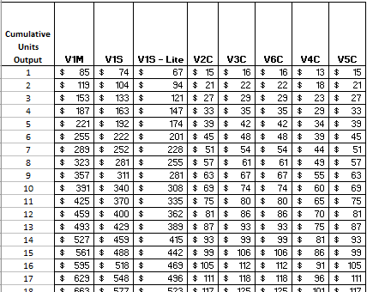
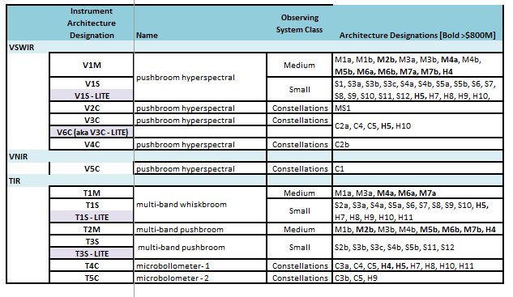
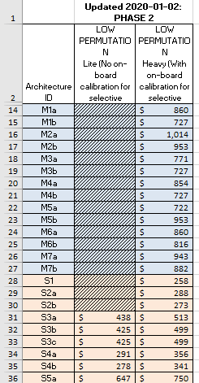
Using a Detailed Architecture Option Spreadsheet to track and document down-select decisions
2. Low Permutation (LP) Lite option costs for selective instrument defined as no On-Board Calibration)
3. Low Permutation (LP) heavy option costs for instruments with On-Board Calibration.
6. Easy viewing of Architecture Designation for each Instrument type
4 & 5. Cost table that captures instrument costs + cumulative RE costs
1. Science Score with cost
Pre-decisional - For Discussion Purposes Only
20

Slide 21
Funnel - from “Many” to “Few”
Potential Options
Large number of permutations
Feasible Options
Perform mission-level design center sessions (LaRC, JPL, GSFC)
Promising Options
3 with 1 recommendation
Provide to HQ with supporting info
Broad exploration of potential trade space
High-level metrics used to consolidate and prune
Instrument Feasibility, Science Value and Cost
Create hybrids and combinations
Identify primary drivers and play against SATM
Assess using parametrics and analogy-based models
Programmatics
100s
Filter – Cost & Value
Filter – Instrument Risk
Programmatic Scenarios
Concept Design Center Studies
Independent Assessment
10s
few
Phase 1
Phase 3
Jun-Jul 2020
Mar-May 2020
Jan-Feb 2020
Oct 2019
Number of Observing System Architectures
Pre-decisional - For Discussion Purposes Only
21

Slide 22
Updated Assessment Approach – Design Sessions
Identified in Phase 2 that promising architectures shared specific elements (e.g. TIR freeflyer, constellation of VSWIRs)
Top 25 options can be constructed from 7 architecture elements
Moved away from single architecture evaluation workshop originally envisioned during study phase 1
Instead, leveraging multi-center nature of the team to schedule design sessions to mature and refine estimates for specific elements
Upcoming collaborative sessions at LaRC in March, JPL in April, GSFC in May, and offline study with ARC initiated
Architecture level estimates can be reconstructed using the elements

Slide 23
Identifying Design Study Candidates (1 of 2)
Approximately 25 candidate architectures remain in the architecture trade space
Pruning based on initial architecture cost estimates and updates following the Team-I study incorporating Subject Matter Expert findings
Evaluating options for pruning based on science value thresholds
Science value scores for the remaining candidates range from 4.70 to 7.45 (max 8 possible)
>15 candidates score greater than 6.5
>10 candidates score greater than 7.0

Slide 24
Identifying Design Study Candidates (2 of 2)
The remaining candidates can be decomposed into individual 7 architecture elements
Medium spacecraft with wide-swath VSWIR and W/P TIR
Medium spacecraft with wide-swath VSWIR and P/B TIR
Small spacecraft with wide-swath VSWIR
Small spacecraft with Whisk Push TIR
Small spacecraft with Push Broom TIR
Constellation spacecraft with bolometer
Constellation spacecraft with narrow-swath VSWIR
The architecture elements will be used as the basis for design studies and then the results for each element will be combined to rebuild the candidate architectures
Updated and refined estimates for cost effectiveness

Slide 25
Information Used for Evaluation
Architecture description and high-level technical specifications
Architecture variants if any (e.g., payload architecture options)
Factors for Science and Applications Value Assessment
Key observation performance parameters -- Instrument capability
Applications value: revisit time & data latency
Mission Classification (A/B/C) – mission duration
Cost Work Breakdown Structure (1-PM, 2-PSE, 3-S&MA, 4-Science, 5-Payload, 6-Spacecraft, 7-MOS, 8-LV, 9-GDS, 10-ATLO, Reserves)
Input Data for design centers’ assessments & Study Reports
Cost (to NASA) estimation approach & cost model input parameters
High-level schedule with dependencies
Risk list or Technology maturation plans (as applicable)
Pre-decisional - For Discussion Purposes Only
25

Slide 26
SBG RFI Update
The SBG Request for Information (RFI) was first released in June 2019 in conjunction with the community workshop
An update was released in early March 2020 to solicit additional information from the initial respondents and for potential new responses
Additional information regarding instrument technical characteristics are requested in the update to support the activities during SBG study Phase 2
Includes a template for responding with an initial list of parameters focused on instrument accommodations for spacecraft compatibility to serve as a response template
Available at: https://beta.sam.gov/ , Solicitation # is WH-01-20

Slide 27
SBG Assessment Path Forward
April: SBG design study at JPL
SBG design study at LaRC
May: SBG design study at GSFC
SBG design study at ARC
SBG Community Telecon #2
July: SBG Architecture Recommendations
Aug-Sept: NASA Selects SBG Architecture

Slide 28
Questions?
Dave Bearden, SBG Phase 2 Lead (JPL)
Jon Chrone, SBG Phase 2 Deputy (LaRC)

