Slide 1
SBG Research and Applications Support for Architecture
Dave Schimel, JPL/Caltech
Ben Poulter, GSFC
Co-leads

Slide 2
SBG Research and Applications Team
Jamie Nastal
Study Lead
Chip Miller
International Coordination
Research and Applications Steering Committee
Dave Schimel
Ben Poulter
RA Co-leads
Science Systems Engineering
Ryan Pavlick
Natasha Stavros
Shannon Zareh
David Thompson
Algorithms
Kerry Cawse-Nicholson
Phil Townsend
Cal/Val
Kevin Turpie
Ray Kokaly
Applications
Jeff Luval
Christine Lee
Stephanie Uz
Modeling
Ben Poulter
Shawn Serbin
Weile Wang

Slide 3
Outline
Define Capability Needs- Architecture Tradespace
Phase 1
Community Inputs via Working Groups
Process for Integrating Community Needs
Synthesized Capability Needs
Architecture Element Design Session Participation
Phase 2
Outcomes of Research and Applications input to Design Sessions
Assess Instruments
Build Architectures
Next Steps:
  Gather input on community perspective of architecture
  Research and Applications involvement going forward
3 Recommendations
HQ Selection

Slide 4
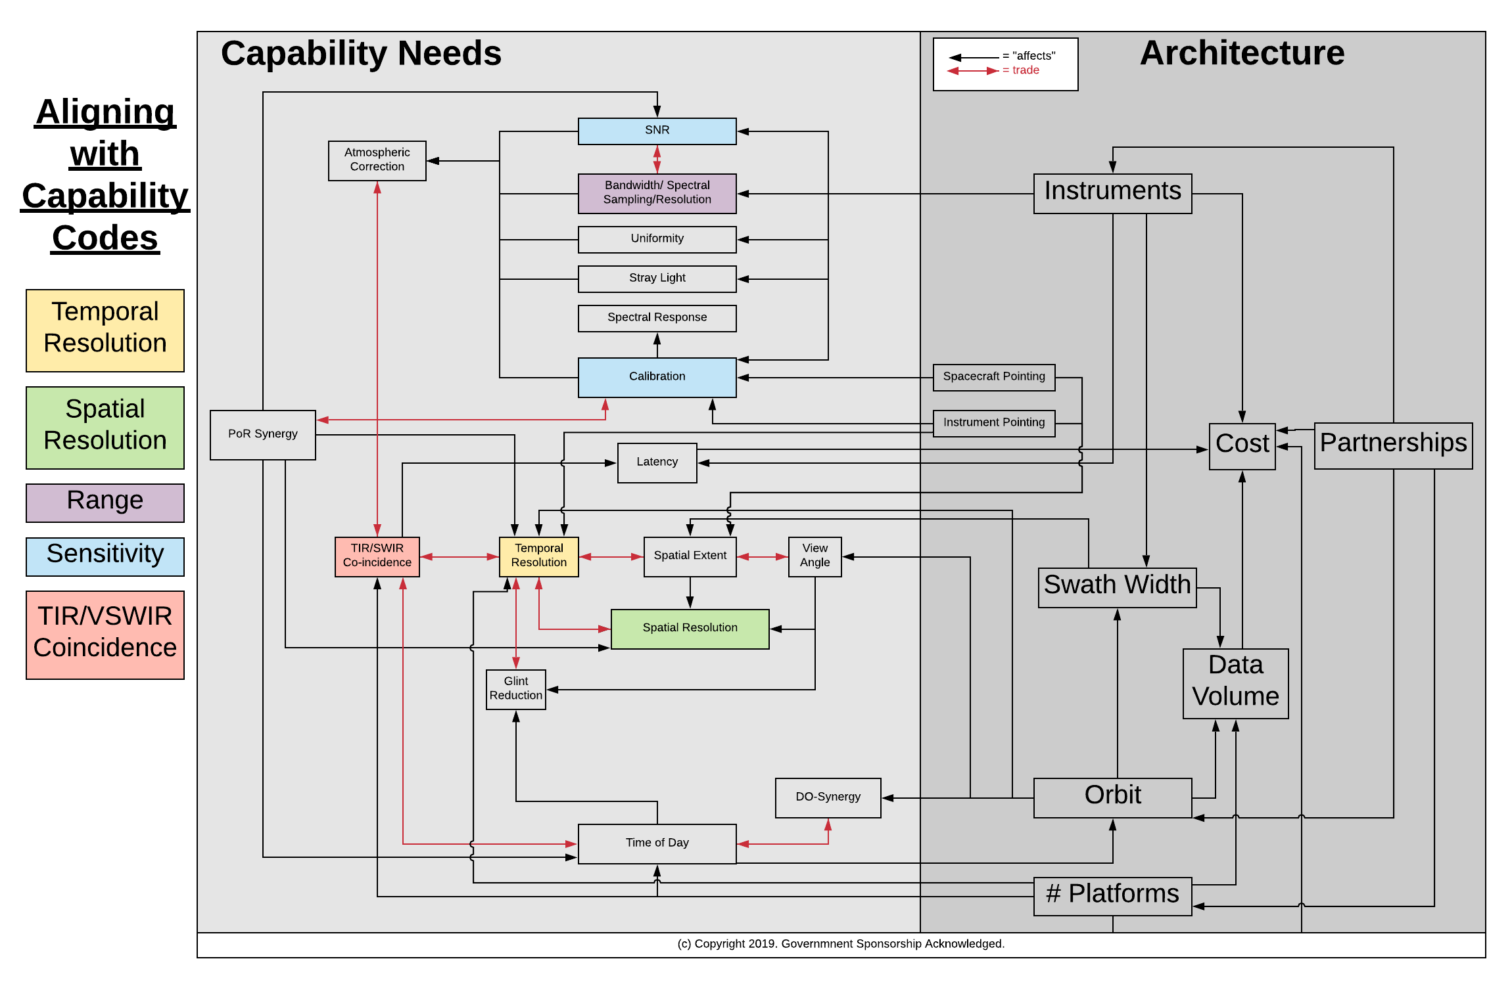
Defining the Capability Needs – SBG Observing System Architecture Tradespace helped to determine:
Define Capability Needs- Architecture Tradespace
Phase 1
Community Inputs via Working Groups
What capability needs influence the value of the data
Any trades among capabilities
How architectural elements affect those capability needs
Synthesized Capability Needs
Architecture Element Design Session Participation
Phase 2
Assess Instruments
Build Architectures
3 Recommendations
See Back-Up material (Slide 20) for more detail
HQ Selection

Slide 5
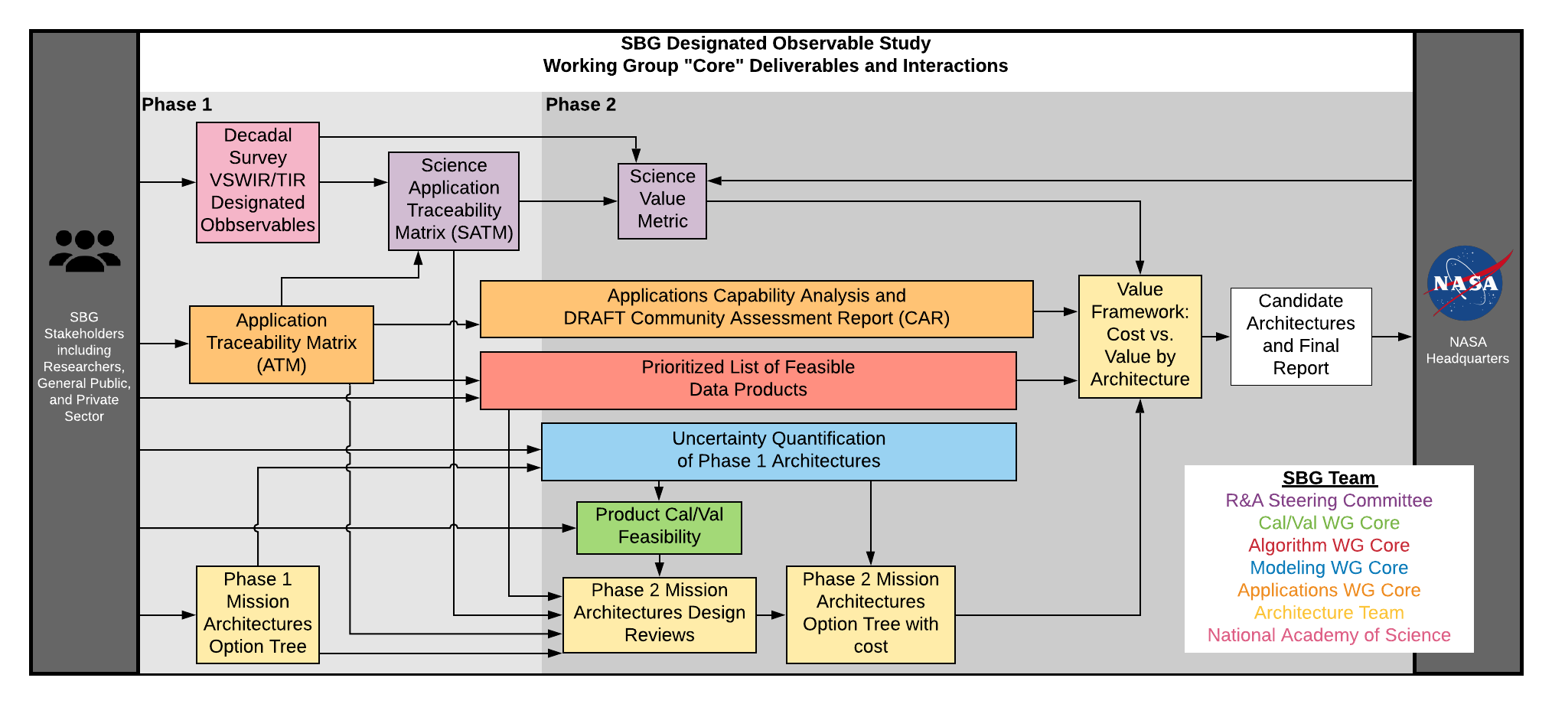
Public WGs gathered community input to directly inform the input parameters for design sessions
Define Capability Needs- Architecture Tradespace
Phase 1
Applications assessed decision-support and applied science capabilities
Algorithms verified capabilities identified in ESAS based on algorithms review
Modeling conducted uncertainty quantification and instrument sensitivity analyses
CalVal provided strategies for pre-launch and on-orbit cal/val activities as input to design sessions
Community Inputs via Working Groups
Synthesized Capability Needs
Architecture Element Design Session Participation
Phase 2
Assess Instruments
Build Architectures
3 Recommendations
HQ Selection

Slide 6
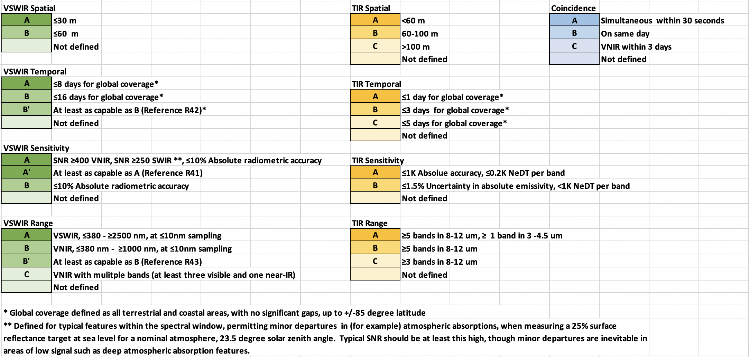
Capability Needs were transcribed into Capability Codes for the Science and Application Traceability Matrix (SATM)
Define Capability Needs- Architecture Tradespace
Phase 1
Community Inputs via Working Groups
Synthesized Capability Needs
Architecture Element Design Session Participation
Phase 2
Assess Instruments
Build Architectures
3 Recommendations
HQ Selection

Slide 7
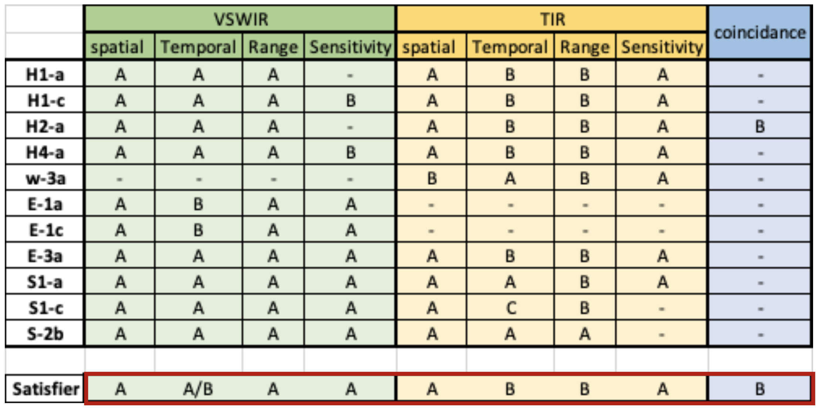
Phase 1 conducted an analysis to find the capability code combination to satisfy ≧70% of science and application needs based on the Decadal Survey (ESAS 2017)
Define Capability Needs- Architecture Tradespace
Phase 1
Community Inputs via Working Groups
Synthesized Capability Needs
coincidence
Architecture Element Design Session Participation
Phase 2
Assess Instruments
Build Architectures
3 Recommendations
HQ Selection

Slide 8
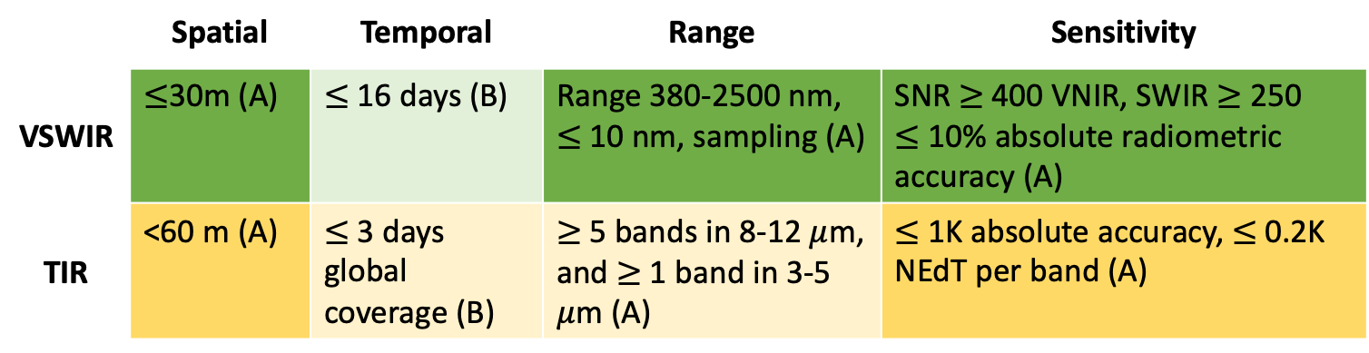
Algorithm WG verified Phase 1 ESAS Assessment for optimal capability code combination by analyzing across 125 (of the 273 identified) algorithms
Ten final product suites were identified
  Based on algorithm maturity
  And decadal survey science questions
Algorithm requirements listed in terms of SATM capability codes
The following capabilities meet all cliff requirements (i.e. the full set of algorithms is not possible to implement with ABAA-ABBA):
Define Capability Needs- Architecture Tradespace
Phase 1
Community Inputs via Working Groups
Synthesized Capability Needs
Architecture Element Design Session Participation
Phase 2
Assess Instruments
 | Spatial | Temporal | Range | Sensitivity
VSWIR | $≤$30m (A) | $≤$ 16 days (B) | Range 380-2500 nm, $≤$10 nm, sampling (A) | SNR $≥$ 400 VNIR, SWIR $≥$ 250 $≤$ 10% absolute radiometric accuracy (A)
TIR | <60 m (A) | $≤$ 3 days global coverage (B) | $≥$5 bands in 8-12 $μ$m, and $≥$ 1 band in 3-5 $μ$m (A) | $≤$1K absolute accuracy, $≤$0.2K NEdT per band (A)
Build Architectures
3 Recommendations
HQ Selection

Slide 9
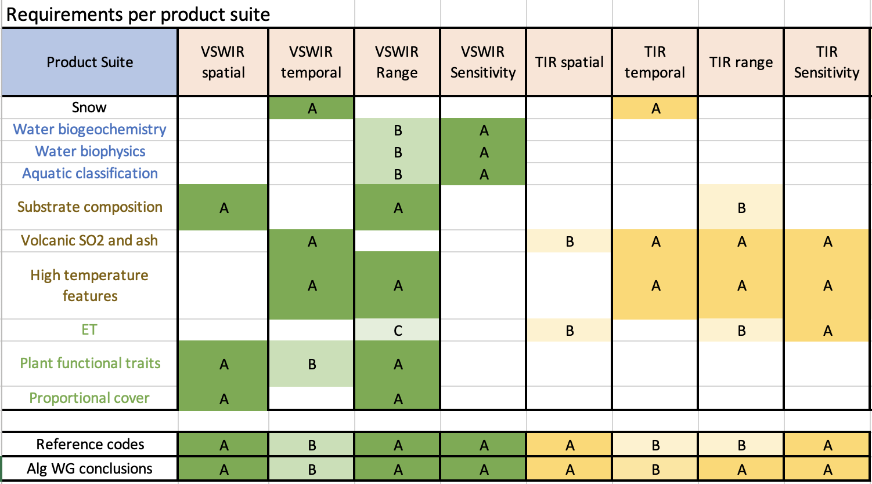

Define Capability Needs- Architecture Tradespace
Primary Finding: Adding a 4 $μ$m band would allow existing algorithms to be implemented for volcano suites
Phase 1
Community Inputs via Working Groups
Synthesized Capability Needs
Architecture Element Design Session Participation
Phase 2
Assess Instruments
Build Architectures
3 Recommendations
HQ Selection
*A blank box indicates no algorithm dependency on that parameter

Slide 10
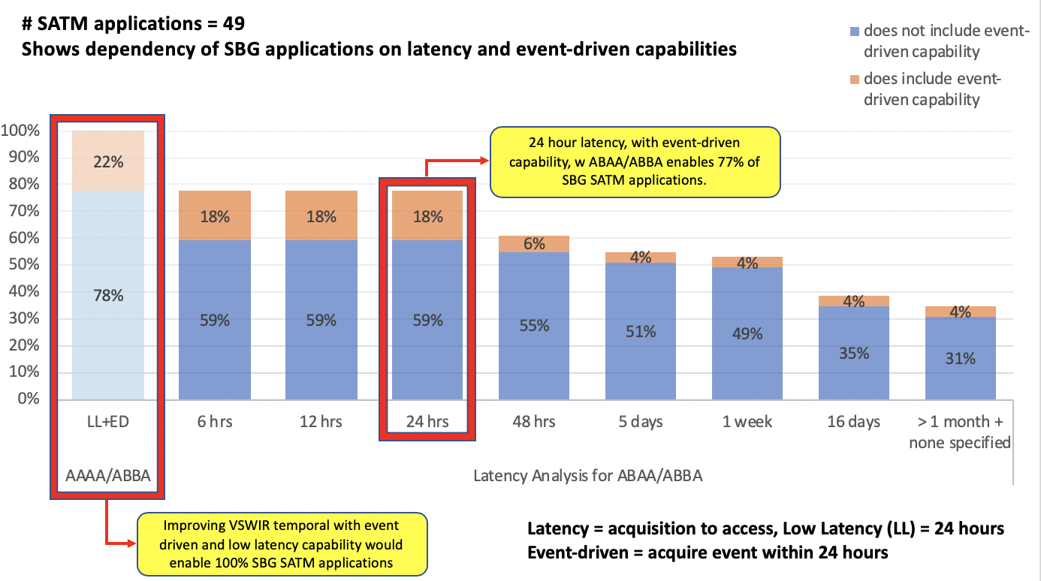
Improving VSWIR temporal with event-driven and low latency capability would enable 100% of SBG SATM capabilities
Define Capability Needs- Architecture Tradespace
Phase 1
Community Inputs via Working Groups
Synthesized Capability Needs
Architecture Element Design Session Participation
Phase 2
Assess Instruments
Build Architectures
3 Recommendations
HQ Selection

Slide 11
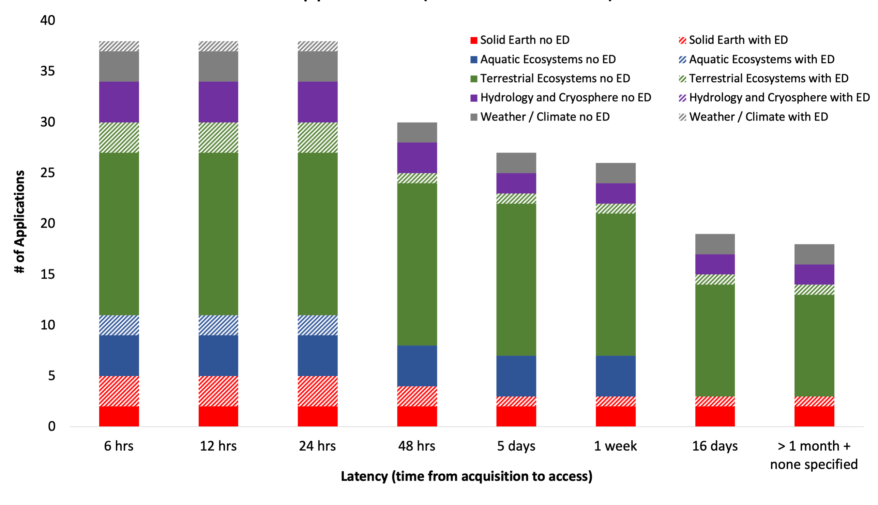
ABAA/ABBA with <24 hr latency and event-driven capability enables 77% applications (38 of 49 total) evenly distributed across disciplines
Define Capability Needs- Architecture Tradespace
Phase 1
Community Inputs via Working Groups
Synthesized Capability Needs
Architecture Element Design Session Participation
Phase 2
Assess Instruments
Build Architectures
3 Recommendations
HQ Selection

Slide 12
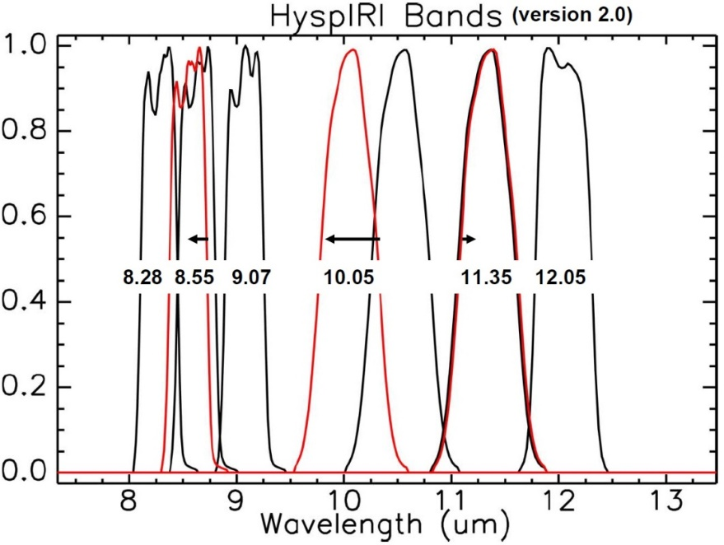
Modeling WG conducted uncertainty quantification using different VSWIR and TIR instrument models
Define Capability Needs- Architecture Tradespace
Phase 1
Community Inputs via Working Groups
Synthesized Capability Needs
Architecture Element Design Session Participation
Phase 1
Assess Instruments
Build Architectures
3 Recommendations
(left) example of VSWIR instrument models and how SNR varies with respect to wavelength
(right) example of TIR instrument model, with switching of band placement
HQ Selection

Slide 13
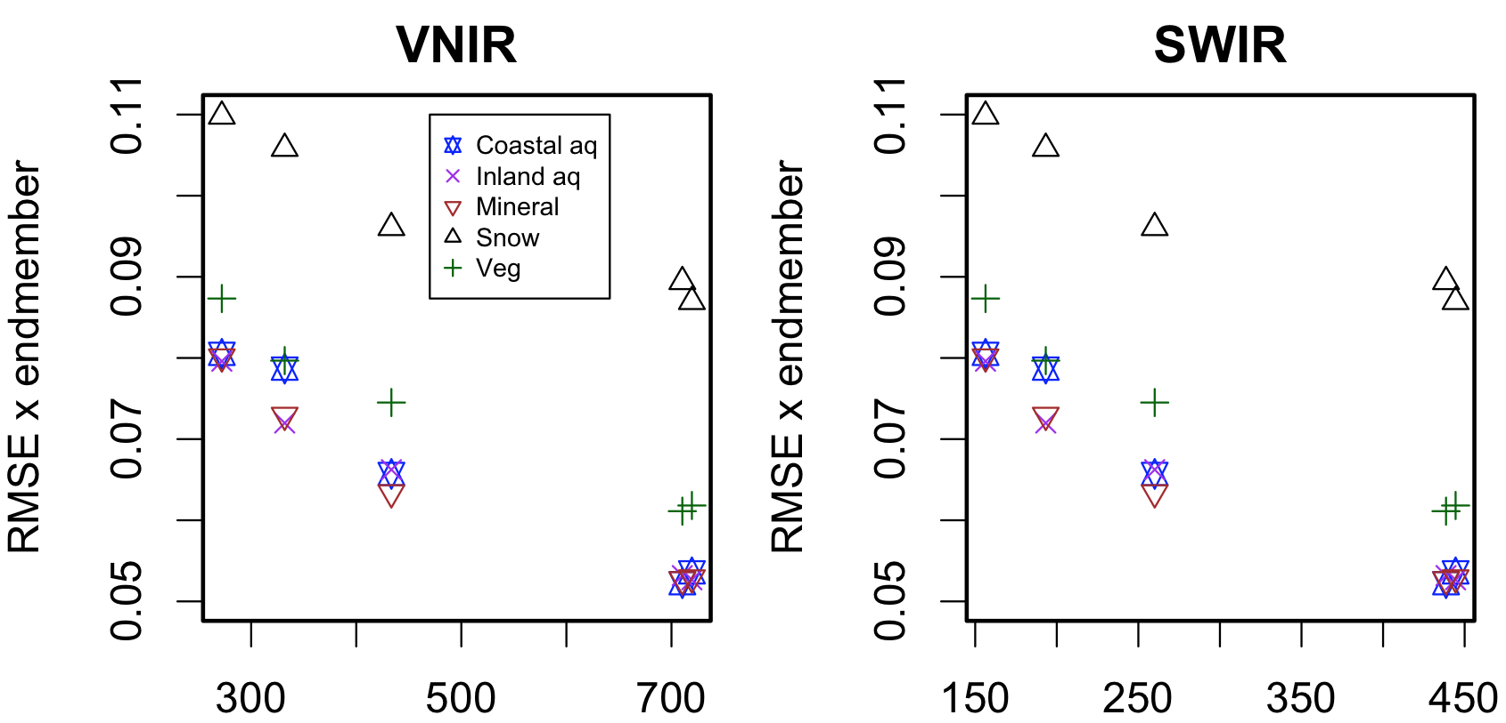
Modeling WG conducted uncertainty quantification for VSWIR instrument models
Define Capability Needs- Architecture Tradespace
HYPERTRACE software developed to evaluate VSWIR instrument model performance for different research areas under varying atmospheres, sun-sensor geometries, and retrieval algorithms.
Instrument model SNR defined by integration Time = f(SNR by band, altitude, GSD, F#, pixel pitch)
Phase 1
Community Inputs via Working Groups
Synthesized Capability Needs
SBG Class A
SBG Class A
Architecture Element Design Session Participation
Phase 2
RMSE by endmember
RMSE by endmember
Assess Instruments
Build Architectures
3 Recommendations
HQ Selection
Signal to noise ratio

Slide 14
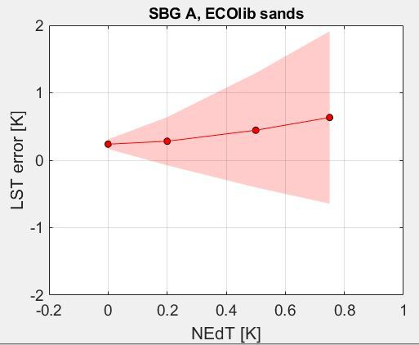
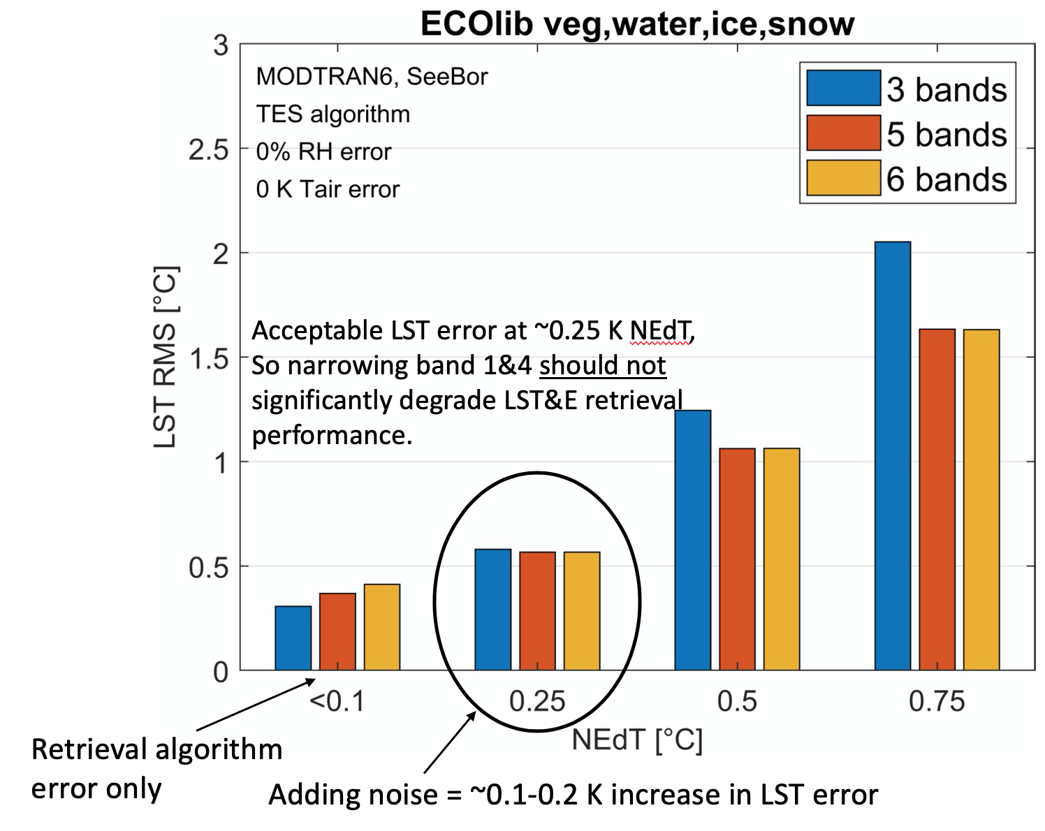
Modeling WG conducted uncertainty quantification for TIR instrument models
Define Capability Needs- Architecture Tradespace
TEUsim software adapted to evaluate TIR instrument model performance for the ECOLIB spectral library, using MODTRAN and the SeeBor V4.0 radiosonde profiles, and three sensor view angles.
Instrument model SNR defined by per-band NEdT.
Phase 1
Community Inputs via Working Groups
Synthesized Capability Needs
SBG Class A
Architecture Element Design Session Participation
Phase 2
Assess Instruments
Build Architectures
3 Recommendations
HQ Selection

Slide 15






CalVal WG provided calibration strategies for achieving desired uncertainty tolerance as input to design sessions
Define Capability Needs- Architecture Tradespace
Phase 1
Community Inputs via Working Groups
Calibration: Radiometric (R), Thermal (T), Spectral (S), & Geometric (G)
Calibration strategy recommendations for architectures assumed:
  Accuracy → 5% rel. uncertainty surface reflectance, inc. dark targets
        → ≤ 1°K abs. uncertainty surface temperature
        → Pointing knowledge for subpixel geometric accuracy
  Stability → Change detection, geolocation and global mosaicking
Synthesized Capability Needs
Architecture Element Design Session Participation
Phase 2
Assess Instruments
 | Guidance to Architecture Team |  | Purpose
On-Orbit Calibration and Monitoring |  | Lunar Calibration (R,S,G) | Accuracy | Stability (long-term)
 |  | Solar Calibration (R,S) | Accuracy | Stability (short-term)
 |  | Black Body (T) | Accuracy | Stability (short-term)
 |  | Stellar Navigation (G) | Maneuvers, Geolocation
 |  | Vicarious Calibration (R,T,S,G) | Accuracy | Stability (long-term)
Build Architectures
3 Recommendations
HQ Selection

Slide 16
All synthesized capabilities were used as direct input and constraints considered by the sub-system engineers in design sessions
Define Capability Needs- Architecture Tradespace
Phase 1
Community Inputs via Working Groups
Synthesized Capability Needs
Key areas of influence were:
  Costing of architectural elements versus constellations (e.g., to meet temporal revisit capability)
  Latency (downlink and compression)
  Flight altitude and orbit effects on spatial resolution and mission lifetime
  Calibration and validation strategies
Architecture Element Design Session Participation
Phase 2
Assess Instruments
Build Architectures
3 Recommendations
HQ Selection

Slide 17
3rd Community Webinar will solicit community perspectives on 3 Candidate Architectures
Define Capability Needs- Architecture Tradespace
Phase 1
Community Inputs via Working Groups
Synthesized Capability Needs
Soliciting community perspective on science and applications impact of the 3 recommended architectures
Form and materials provided to those who register in advance: https://tinyurl.com/sbgwebinar
When: July 15th, 9 AM Pacific/12 pm Eastern
Architecture Element Design Session Participation
Phase 1
Assess Instruments
Build Architectures
3 Recommendations
HQ Selection

Slide 18
SBG is here in its mission life cycle…
Advanced Studies |  | Formulation |  | Implementation
Pre-phase A |  | Phase A | Phase B | Phase C | Phase D | Phase E | Phase F
DO Mission Study | MCR Prep | Mission and System definition | Preliminary Design | Design & Build | Assembly, Test & Launch Ops | Operations | Closeout
If approved by NASA, there will be many opportunities for the R&A community to engage throughout the mission lifecycle, e.g.:
Key and driving requirements will be reassessed in Phase A
The Applications Community Assessment Report will be finished in Phase A
Calibration and Validation strategy definition in Phase A/B and implementation in Phases C-E
Algorithm selection and testing in Phases A-D
Competed Science Team at some point in the mission lifecycle
Current activities: DO Study WGs, MEET-SBG and SISTER

Slide 19
Questions?

Slide 20
Back-Up

Slide 21
Defining the Capability Needs - Architecture Tradespace

Slide 22
Modeling Study –
Modeling End-To-End Traceability for SBG (MEET-SBG)
MEET-SBG provides a framework to quantify L2 uncertainty and error propagation from surface to atmosphere to sensor, and the roles of retrieval methods to support end-to-end traceability of SBG.
The modeling activity is a collaboration between JPL, ARC, GSFC, DOE-BNL, industry, academic institutions, and non-profit organizations. Tasks will be re-evaluated throughout the study to align with the direction and needs of SBG.
MEET-SBG tasks include:
VSWIR uncertainty quantification via the SBG Hypertrace software package for representative cases of SBG focal areas
TIR uncertainty quantification via TEUsim instrument modeling approach for representative cases of SBG focal areas
Land-surface model improvements
Regional to global scale Observing System Simulation Experiment (OSSE) to evaluate Simulation of SBG spectra from existing hyperspectral and multispectral instruments
Engaging and advancing model theoretical algorithms to incorporate SBG L3 products
Providing SBG modeling and evaluation (HYPERTRACE and TEUsim) tools to the research and applications community

Slide 23
Data Pathfinder Study - SBG Space-based Imaging Spectroscopy and Thermal pathfindER (SISTER)
The purpose of SISTER is to prepare the science community for SBG products, and identify and reduce risks in the ground segment.
SISTER is an active collaboration between JPL, ARC, GSFC, industry, academic institutions, and non-profit organizations.
The proposed SISTER tasks, which will be re-evaluated throughout the study to align with the direction and needs of SBG, include:
Adapt and refine existing workflows and architectures as prototype(s) for the SBG science data system;
Examine existing atmospheric correction algorithms for standardized use in a global context for SBG target objectives*;
Examine L2b and L3 algorithm robustness for standardized use in a global context;
Produce pseudo-SBG datasets and identify algorithm and data system challenges for at-scale global production;
Distribute large pseudo-SBG datasets to the user community for evaluation;
Deliver an assessment of approaches for data product calibration and validation and make recommendations to the SBG project, and international partners, regarding value, cost and risk of cal/val approaches for SBG science focus areas;
Educate a new generation of users to VSWIR and TIR data;
Develop an early engagement strategy plan.
*SBG target objectives include terrestrial and marine ecosystems, geology, snow/ice, thermal, and other potential opportunities.

