Slide 1
SBG Community Webinar
Rules of Engagement
Turn off your video
All will be muted
Please use chat to ask a question (Kerry Cawse-Nicholson to read)
Following the presentations, we’ll answer questions.
Any questions we don’t get to will be answered within a week in writing and the answers posted: https://sbg.jpl.nasa.gov/news-events
Please also send questions about the final architectures you’d like to hear about at the 15 July presentation
Contact Dave Schimel or Ben Poulter directly by email or to set up a phone call: dschimel@jpl.nasa.gov or benjamin.poulter@nasa.gov

Slide 2
SBG Research and Applications Support for Architecture
Dave Schimel, JPL/Caltech
Ben Poulter, GSFC
Co-leads

Slide 3
SBG Research and Applications Team
Jamie Nastal
Study Lead
Chip Miller
International Coordination
Research and Applications Steering Committee
Dave Schimel
Ben Poulter
RA Co-leads
Science Systems Engineering
Ryan Pavlick
Natasha Stavros
Shannon Zareh
David Thompson
Algorithms
Kerry Cawse-Nicholson
Phil Townsend
Cal/Val
Kevin Turpie
Ray Kokaly
Applications
Jeff Luval
Christine Lee
Stephanie Uz
Modeling
Ben Poulter
Shawn Serbin
Weile Wang
Luvall

Slide 4
Outline
Define Capability Needs- Architecture Tradespace
Phase 1
Community Inputs via Working Groups
Process for Integrating Community Needs
Synthesized Capability Needs
Architecture Element Design Session Participation
Phase 2
Outcomes of Research and Applications input to Design Sessions
Assess Instruments
Build Architectures
Next Steps:
  Gather input on community perspective of architecture
  Research and Applications involvement going forward
3 Recommendations
HQ Selection

Slide 5
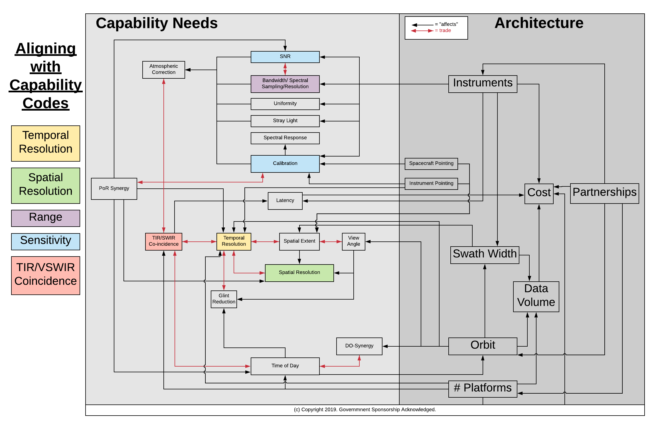
Defining the Capability Needs – SBG Observing System Architecture Tradespace helped to determine:
Define Capability Needs- Architecture Tradespace
Phase 1
Community Inputs via Working Groups
What capability needs influence the value of the data
Any trades among capabilities
How architectural elements affect those capability needs
Synthesized Capability Needs
Architecture Element Design Session Participation
Phase 2
Assess Instruments
Build Architectures
3 Recommendations
See Back-Up material (Slide 38) for more detail
HQ Selection

Slide 6
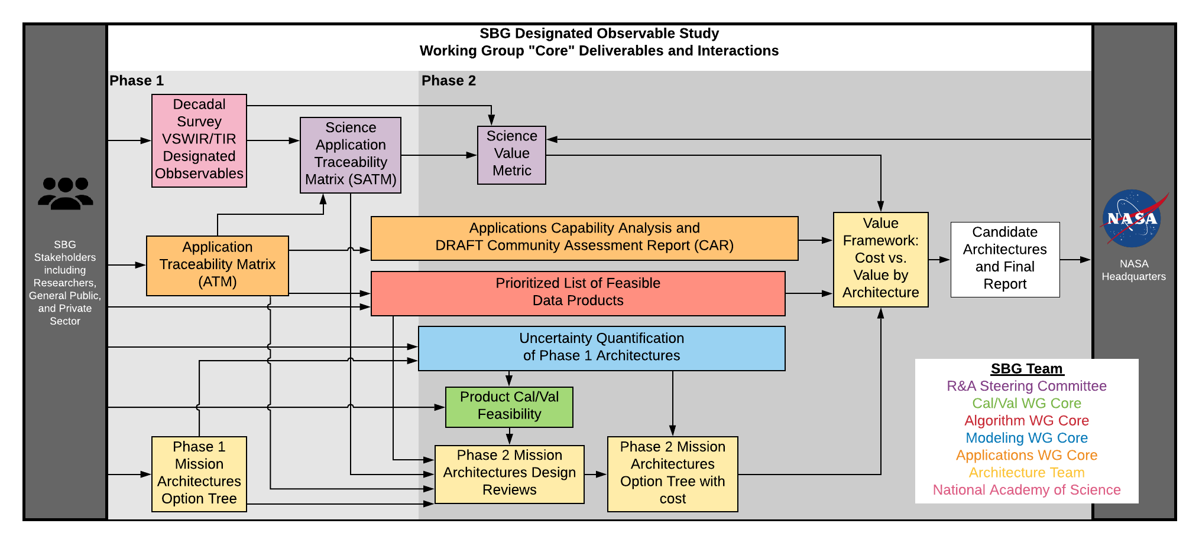
Public WGs gathered community input to directly inform the input parameters for design sessions
Define Capability Needs- Architecture Tradespace
Phase 1
Applications assessed decision-support and applied science capabilities
Algorithms verified capabilities identified in ESAS based on algorithms review
Modeling conducted uncertainty quantification and instrument sensitivity analyses
CalVal provided strategies for pre-launch and on-orbit cal/val activities as input to design sessions
Community Inputs via Working Groups
Synthesized Capability Needs
Architecture Element Design Session Participation
Phase 2
Assess Instruments
Build Architectures
3 Recommendations
HQ Selection

Slide 7
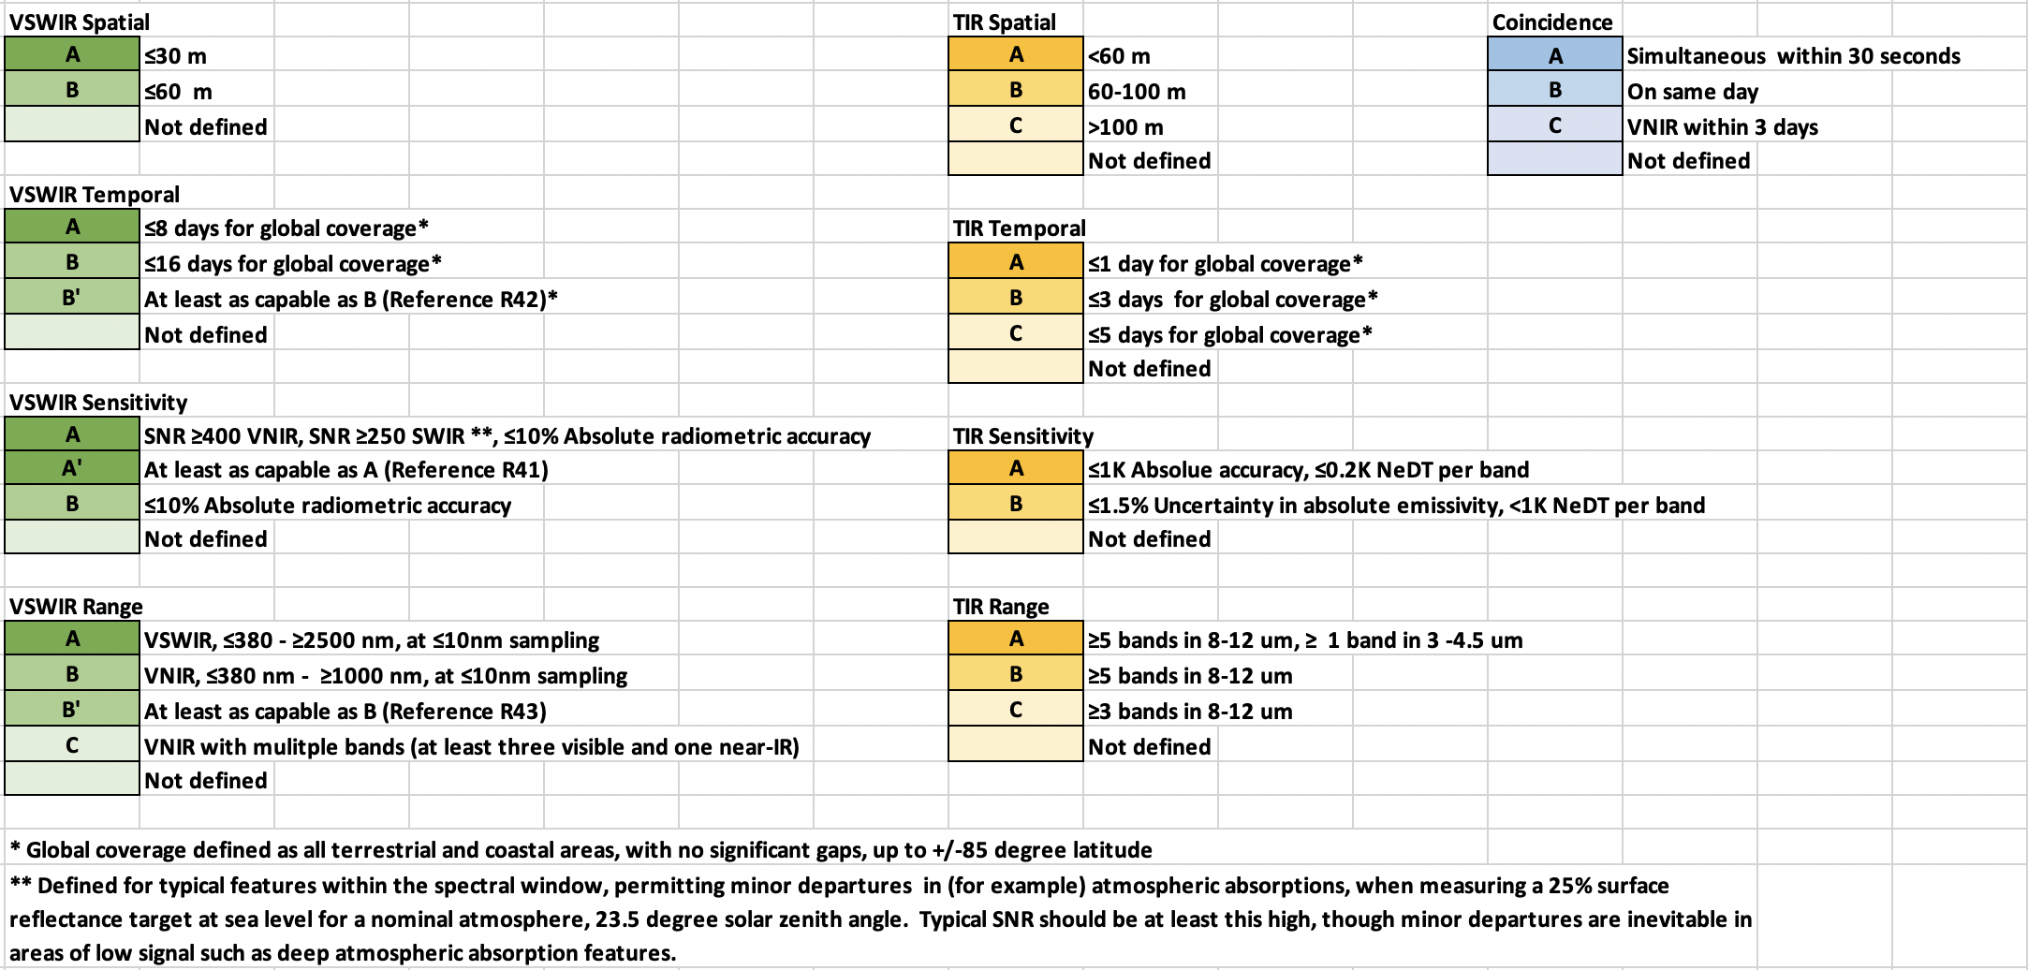
Capability Needs were transcribed into Capability Codes for the Science and Application Traceability Matrix (SATM)
Define Capability Needs- Architecture Tradespace
Phase 1
Community Inputs via Working Groups
Synthesized Capability Needs
Architecture Element Design Session Participation
Phase 2
Assess Instruments
Build Architectures
3 Recommendations
HQ Selection

Slide 8
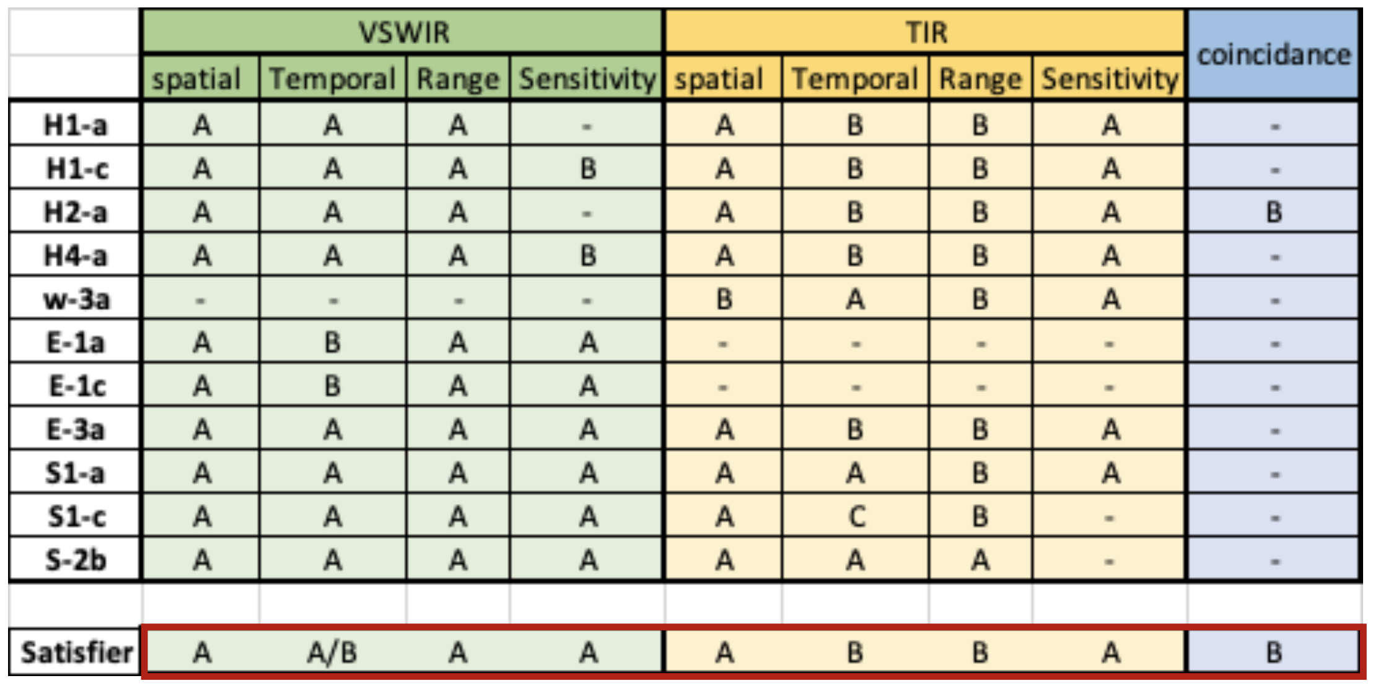
Phase 1 conducted an analysis to find the capability code combination to satisfy ≧70% of science and application needs based on the Decadal Survey (ESAS 2017)
Define Capability Needs- Architecture Tradespace
Phase 1
Community Inputs via Working Groups
Synthesized Capability Needs
coincidence
Architecture Element Design Session Participation
Phase 2
Assess Instruments
Build Architectures
3 Recommendations
HQ Selection

Slide 9
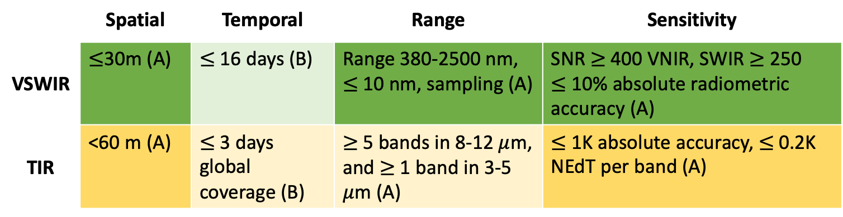
Algorithm WG verified Phase 1 ESAS Assessment for optimal capability code combination by analyzing across 125 (of the 273 identified) algorithms
Ten final product suites were identified
  Based on algorithm maturity
  And decadal survey science questions
Algorithm requirements listed in terms of SATM capability codes
The following capabilities meet all cliff requirements (i.e. the full set of algorithms is not possible to implement with ABAA-ABBA):
Define Capability Needs- Architecture Tradespace
Phase 1
Community Inputs via Working Groups
Synthesized Capability Needs
Architecture Element Design Session Participation
Phase 2
Assess Instruments
 | Spatial | Temporal | Range | Sensitivity
VSWIR | $≤$30m (A) | $≤$ 16 days (B) | Range 380-2500 nm, $≤$10 nm, sampling (A) | SNR $≥$ 400 VNIR, SWIR $≥$ 250 $≤$ 10% absolute radiometric accuracy (A)
TIR | <60 m (A) | $≤$ 3 days global coverage (B) | $≥$5 bands in 8-12 $μ$m, and $≥$ 1 band in 3-5 $μ$m (A) | $≤$1K absolute accuracy, $≤$0.2K NEdT per band (A)
Build Architectures
3 Recommendations
HQ Selection

Slide 10
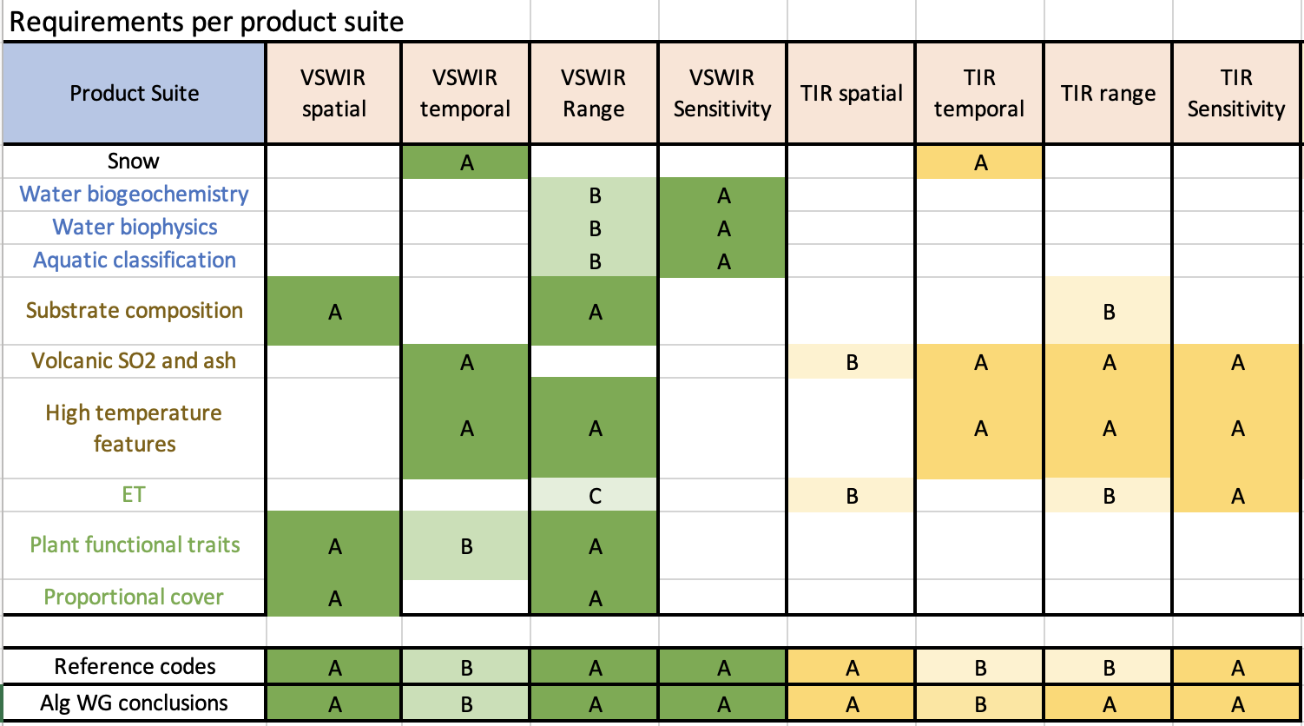

Define Capability Needs- Architecture Tradespace
Primary Finding: Adding a 4 $μ$m band would allow existing algorithms to be implemented for volcano suites
Phase 1
Community Inputs via Working Groups
Synthesized Capability Needs
Architecture Element Design Session Participation
Phase 2
Assess Instruments
Build Architectures
3 Recommendations
Threshold
HQ Selection
*A blank box indicates no algorithm dependency on that parameter

Slide 11
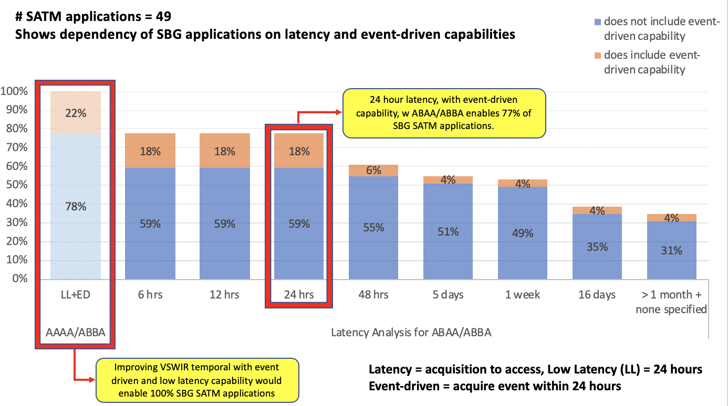
Improving VSWIR temporal with event-driven and low latency capability would enable 100% of SBG SATM capabilities
Define Capability Needs- Architecture Tradespace
Phase 1
Community Inputs via Working Groups
Synthesized Capability Needs
Architecture Element Design Session Participation
Phase 2
Assess Instruments
Build Architectures
3 Recommendations
HQ Selection

Slide 12
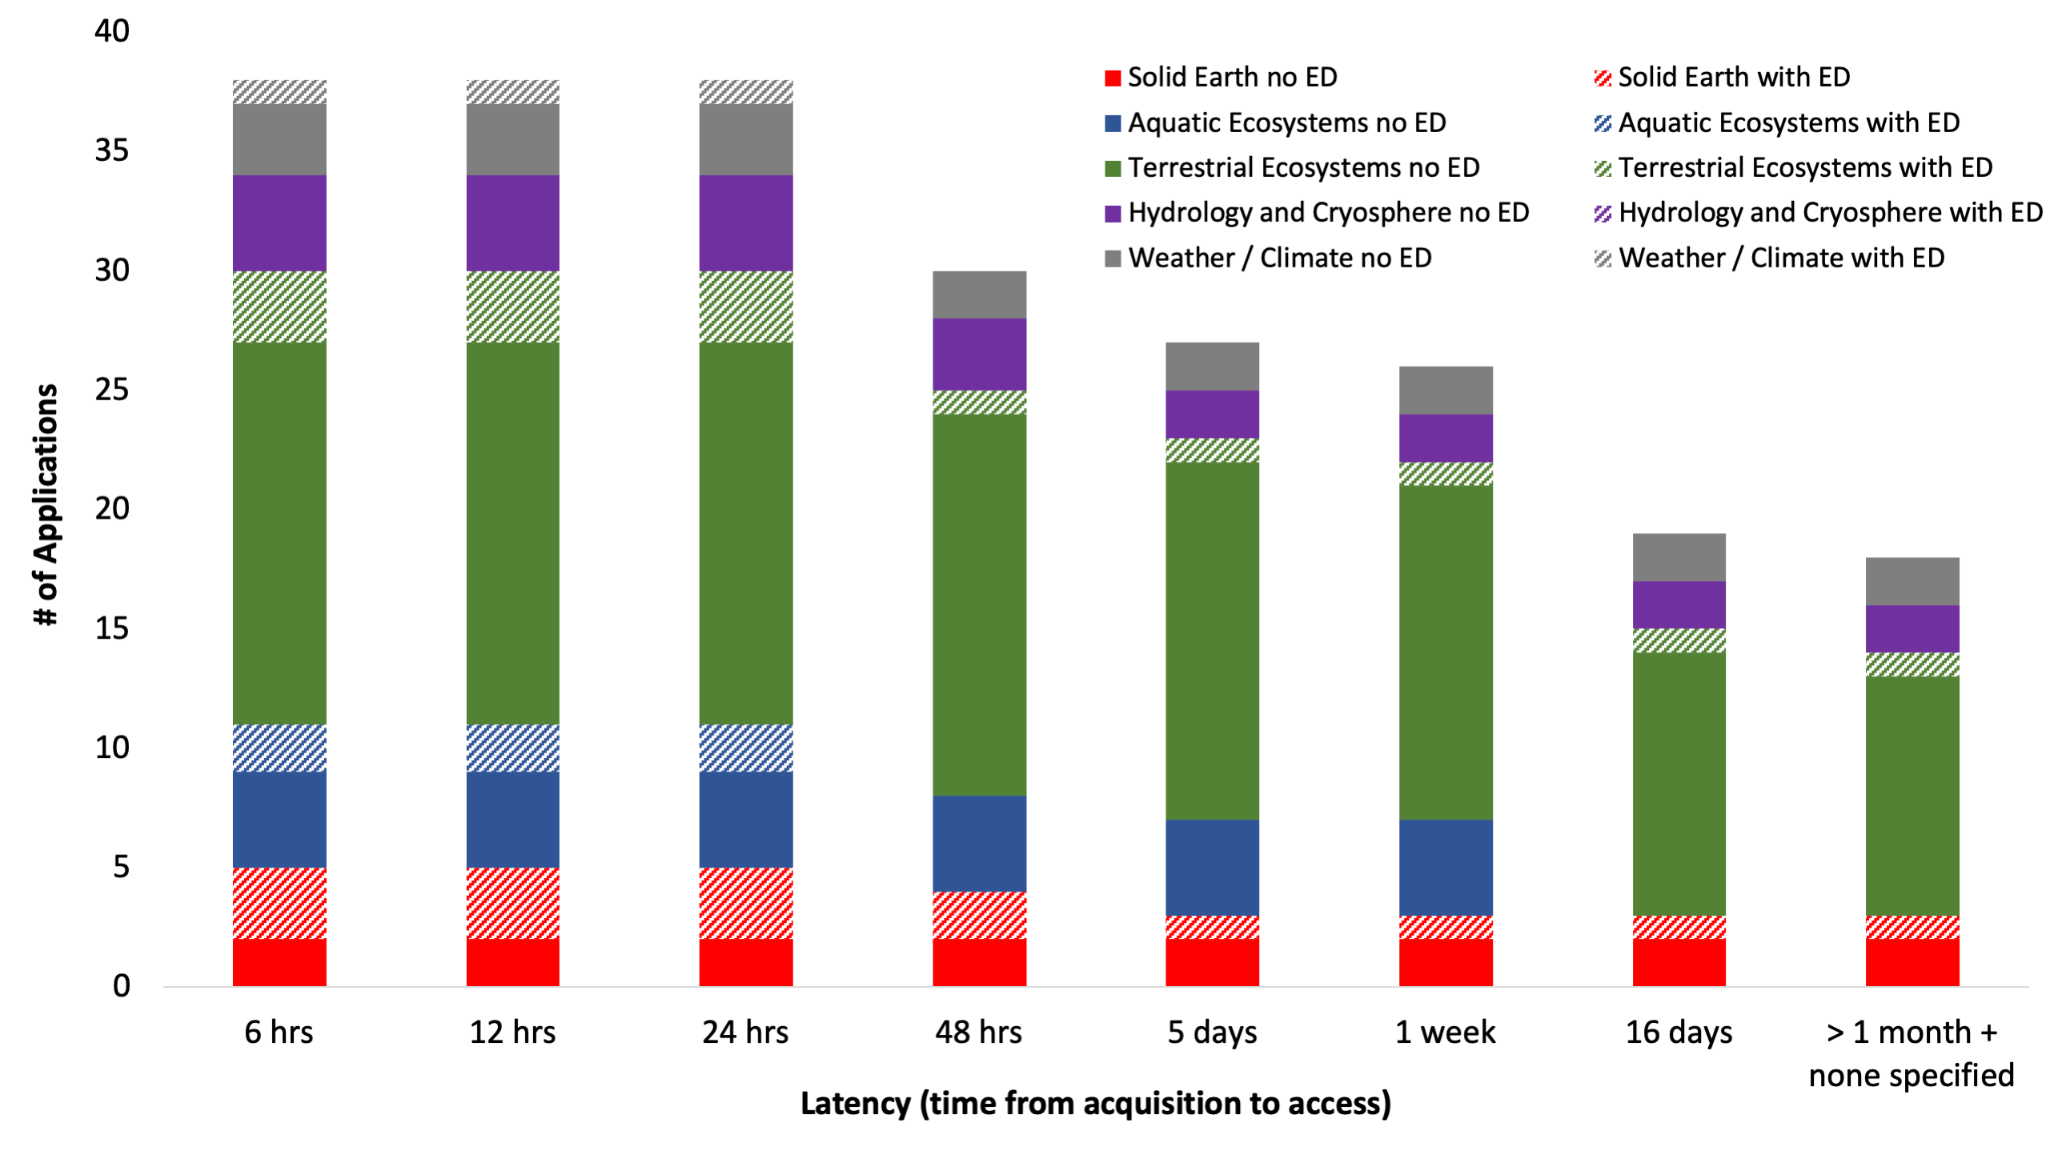
All disciplines need ABAA/ABBA with <24 hr latency and event-driven capability to enable the 77% applications (38 of 49 total)
Define Capability Needs- Architecture Tradespace
Phase 1
Community Inputs via Working Groups
Synthesized Capability Needs
Architecture Element Design Session Participation
Phase 2
Assess Instruments
Build Architectures
3 Recommendations
HQ Selection

Slide 13
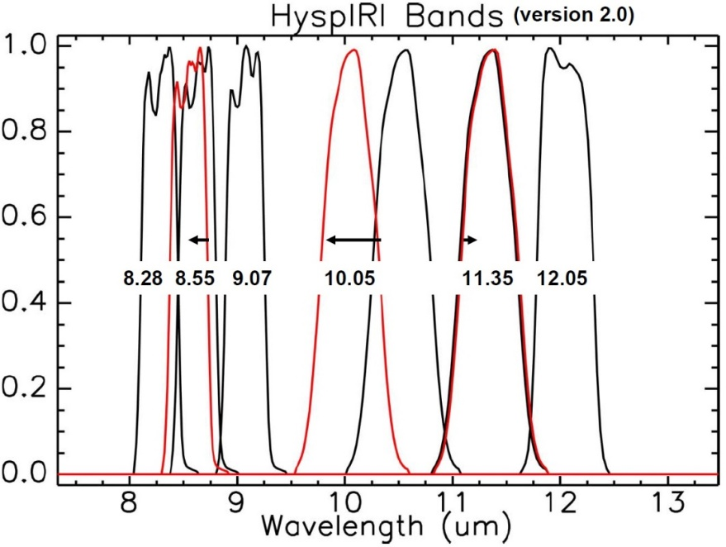
Modeling WG conducted uncertainty quantification using different VSWIR and TIR instrument models
Define Capability Needs- Architecture Tradespace
Phase 1
Community Inputs via Working Groups
Synthesized Capability Needs
Architecture Element Design Session Participation
Phase 1
Assess Instruments
Build Architectures
3 Recommendations
(left) example of VSWIR instrument models and how SNR varies with respect to wavelength
(right) example of TIR instrument model, with switching of band placement
HQ Selection

Slide 14
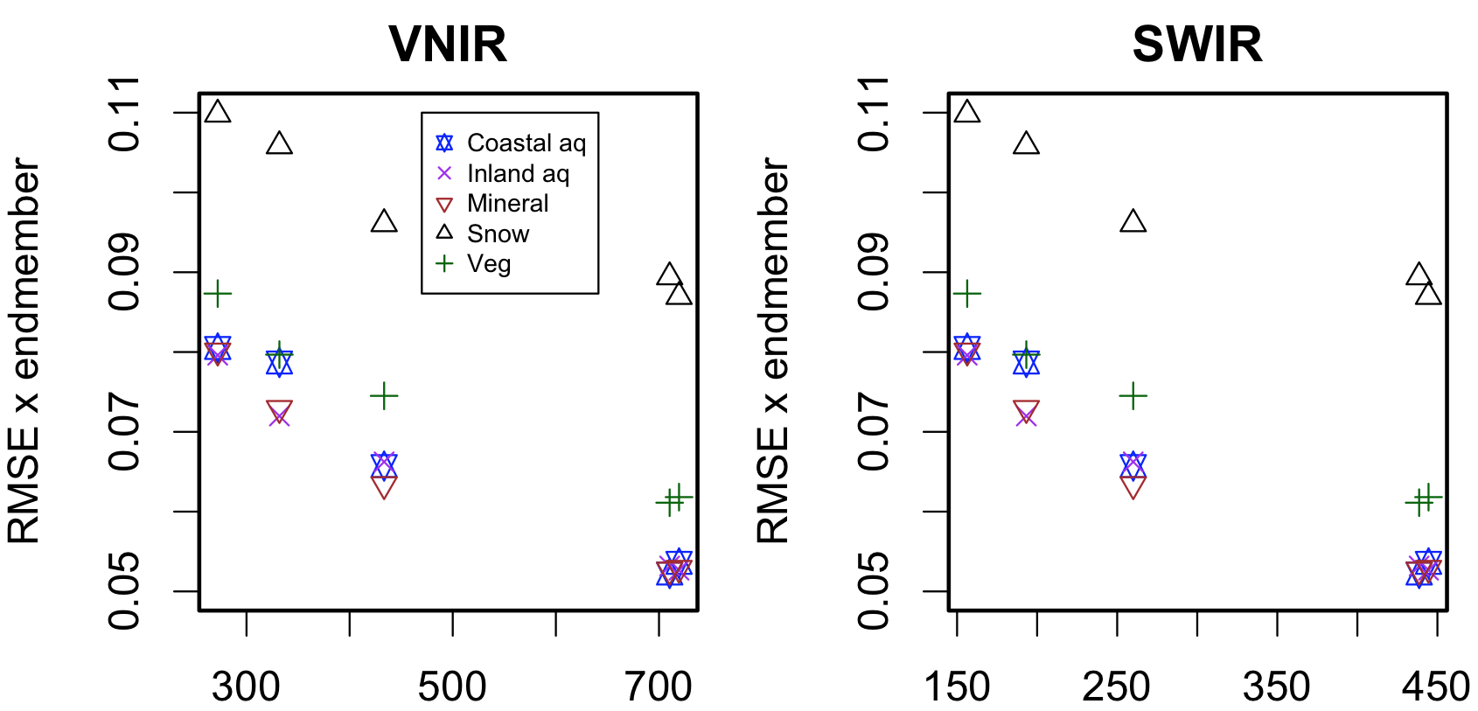
Modeling WG conducted uncertainty quantification for VSWIR instrument models
Define Capability Needs- Architecture Tradespace
HYPERTRACE software developed to evaluate VSWIR instrument model performance for different research areas under varying atmospheres, sun-sensor geometries, and retrieval algorithms.
Instrument model SNR defined by integration Time = f(SNR by band, altitude, GSD, F#, pixel pitch)
Phase 1
Community Inputs via Working Groups
Synthesized Capability Needs
SBG Class A
SBG Class A
Architecture Element Design Session Participation
Phase 2
RMSE by endmember
RMSE by endmember
Assess Instruments
Build Architectures
3 Recommendations
HQ Selection
Signal to noise ratio

Slide 15
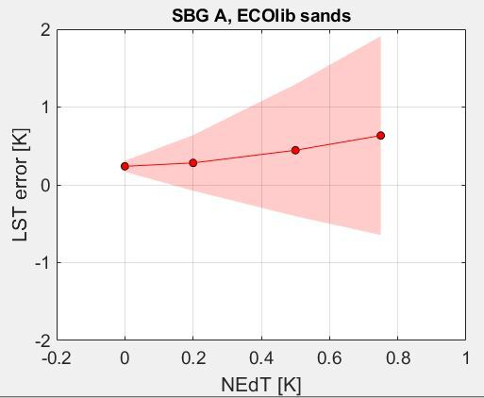
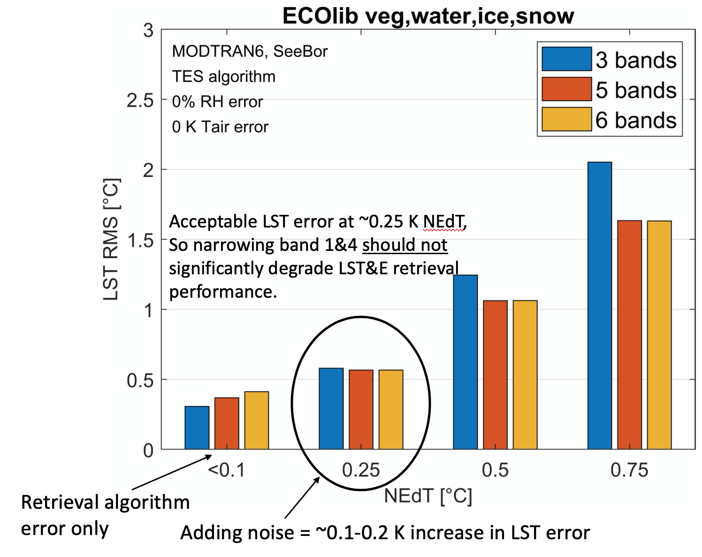
Modeling WG conducted uncertainty quantification for TIR instrument models
Define Capability Needs- Architecture Tradespace
TEUsim software adapted to evaluate TIR instrument model performance for the ECOLIB spectral library, using MODTRAN and the SeeBor V4.0 radiosonde profiles, and three sensor view angles.
Instrument model SNR defined by per-band NEdT.
Phase 1
Community Inputs via Working Groups
Synthesized Capability Needs
SBG Class A
Architecture Element Design Session Participation
Phase 2
Assess Instruments
Build Architectures
3 Recommendations
HQ Selection

Slide 16






CalVal WG provided calibration strategies for achieving desired uncertainty tolerance as input to design sessions
Define Capability Needs- Architecture Tradespace
Phase 1
Community Inputs via Working Groups
Calibration: Radiometric (R), Thermal (T), Spectral (S), & Geometric (G)
Calibration strategy recommendations for architectures assumed:
  Accuracy → 5% rel. uncertainty surface reflectance, inc. dark targets
        → ≤ 1°K abs. uncertainty surface temperature
        → Pointing knowledge for subpixel geometric accuracy
  Stability → Change detection, geolocation and global mosaicking
Synthesized Capability Needs
Architecture Element Design Session Participation
Phase 2
Assess Instruments
 | Guidance to Architecture Team |  | Purpose
On-Orbit Calibration and Monitoring |  | Lunar Calibration (R,S,G) | Accuracy | Stability (long-term)
 |  | Solar Calibration (R,S) | Accuracy | Stability (short-term)
 |  | Black Body (T) | Accuracy | Stability (short-term)
 |  | Stellar Navigation (G) | Maneuvers, Geolocation
 |  | Vicarious Calibration (R,T,S,G) | Accuracy | Stability (long-term)
Build Architectures
3 Recommendations
HQ Selection

Slide 17
All synthesized capabilities were used as direct input and constraints considered by the sub-system engineers in design sessions
Define Capability Needs- Architecture Tradespace
Phase 1
Community Inputs via Working Groups
Synthesized Capability Needs
Key areas of influence were:
  Costing of architectural elements versus constellations (e.g., to meet temporal revisit capability)
  Latency (downlink and compression)
  Flight altitude and orbit effects on spatial resolution and mission lifetime
  Calibration and validation strategies
Architecture Element Design Session Participation
Phase 2
Assess Instruments
Build Architectures
3 Recommendations
HQ Selection

Slide 18
3rd Community Webinar will solicit community perspectives on 3 Candidate Architectures
Define Capability Needs- Architecture Tradespace
Phase 1
Community Inputs via Working Groups
Synthesized Capability Needs
Soliciting community perspective on science and applications impact of the 3 recommended architectures
Form and materials provided to those who register in advance: https://tinyurl.com/sbgwebinar
When: July 15th, 9 AM Pacific/12 pm Eastern
Architecture Element Design Session Participation
Phase 1
Assess Instruments
Build Architectures
3 Recommendations
HQ Selection

Slide 19
SBG is here in its mission life cycle…
Advanced Studies |  | Formulation |  | Implementation
Pre-phase A |  | Phase A | Phase B | Phase C | Phase D | Phase E | Phase F
DO Mission Study | MCR Prep | Mission and System definition | Preliminary Design | Design & Build | Assembly, Test & Launch Ops | Operations | Closeout
If approved by NASA, there will be many opportunities for the R&A community to engage throughout the mission lifecycle, e.g.:
Key and driving requirements will be reassessed in Phase A
The Applications Community Assessment Report will be finished in Phase A
Calibration and Validation strategy definition in Phase A/B and implementation in Phases C-E
Algorithm selection and testing in Phases A-D
Competed Science Team at some point in the mission lifecycle
Current activities: DO Study WGs, MEET-SBG and SISTER

Slide 20
SBG: Architecture Status
May 27, 2020
Dave Bearden, Phase 2 Lead, Jet Propulsion Laboratory, California Institute of Technology
Jon Chrone, SBG Phase 2 Deputy Lead, Langley Research Center
Pre-decisional - For Discussion Purposes Only

Slide 21
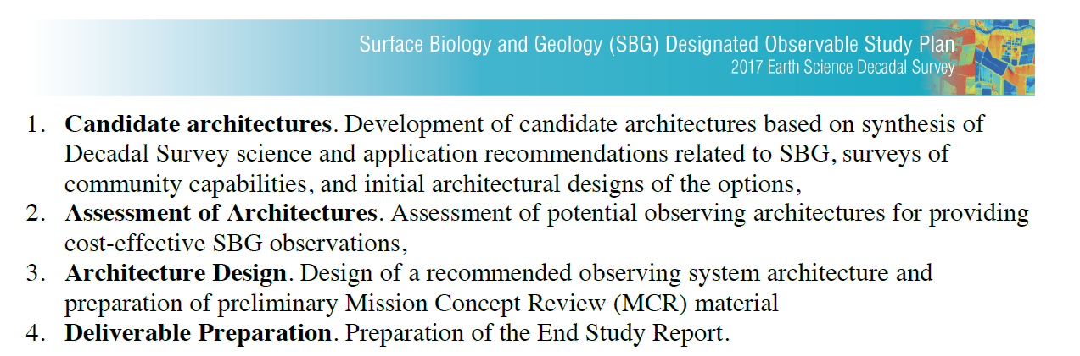
SBG Study Scope
Pre-decisional - For Discussion Purposes Only

Slide 22
Architecture Evaluation Objectives
Identify architectures to support research and applications objectives
Develop Value Framework to evaluate architecture solutions to most/very important science and applications objectives performance, risk, cost, schedule
Assess a diverse set of high RA value SBG observing architectures and reduce down to a few promising architectures
Provide justification for eliminating candidate architectures
Pre-decisional - For Discussion Purposes Only

Slide 23
SBG Architecture Concept Flow to Initial Value Assessment
Define Arch. Elements
Choose Instruments
Instrument Capability
Size Systems
number, type
Use capability levels (A, B, C) as outlined in the SATM
Estimate Cost
Multiple capabilities within an architecture family
Instrument – parametrics
Spacecraft – S/M/L heuristics
Percentage wraps for other elements
Launch – table of options
Map to Decadal Priorities
Smallsat, constellations
Combinations, etc.
TIR, VSWIR
Objectives met by system: MI/VI/I
Plot Value vs. Cost
Compare with threshold (80%) and baseline (100%)
Include partnerships
Select launch vehicle
Flagship, Largesat, Mediumsats
Parametrics to estimate mass, power
Non-space elements
Assess performance: resolution, SNR, revisit, etc.
Number of Platforms & Orbits
Assess Value
Place highest value on most important objectives
Include credit for applications
Parameters: Spatial, Temporal, Spectral Range & Sensitivity
1. Architecture Definition
2. Value - Effectiveness
3. Cost Effectiveness - Comparisons
Pre-decisional - For Discussion Purposes Only

Slide 24
Value Framework Overview
SBG Value Framework assesses key features relevant to decision criteria while providing the ability to discriminate between alternatives
Quantitative features
  Capability (Science & Applications)
  Cost / Affordability
  Schedule
  Risk
Qualitative features
  Programmatic factors
  International Partnerships
Pre-decisional - For Discussion Purposes Only

Slide 25
Funnel - from “Many” to “Few”
Potential Options
Large number of permutations
Feasible Options
Perform mission-level design center sessions (LaRC, JPL, GSFC)
Promising Options
3 with 1 recommendation
Provide to HQ with supporting info
Broad exploration of potential trade space
High-level metrics used to consolidate and prune
Instrument Feasibility, Science Value and Cost
Create hybrids and combinations
Identify primary drivers and play against SATM
Assess using parametrics and analogy-based models
Programmatics
100s
  Filter – Cost & Value
  Filter – Instrument Risk
  Programmatic Scenarios
  Concept Design Center Studies
  Independent Assessment
10s
few
Phase 1
Phase 3
Jun-Jul 2020
Mar-May 2020
Jan-Feb 2020
Oct 2019
Number of Observing System Architectures
Pre-decisional - For Discussion Purposes Only
24

Slide 26
SBG Study Schedule
Successfully executed web-based Design sessions/studies hosted by JPL, LaRC, ARC, GSFC
Changed Community Workshop to Webinars
Pre-decisional - For Discussion Purposes Only

Slide 27
SBG RFI Update
The SBG Request for Information (RFI) was first released in June 2019 in conjunction with the community workshop
An update was released in early March 2020 to solicit additional information from the initial respondents and for potential new responses
  Additional information regarding instrument technical characteristics were requested in the update to support the activities during SBG study Phase 2
  Released amended RFI with proprietary data allowed and a table addendum with specific instrument accommodation information. Timeliness of responses has been critical to the evaluation process
Received 6 responses to date (RFI remains active through July)
  5 were updates to previous responses
  2 new responses; expecting additional responses
  Responses span NASA centers, private companies, international and traditional/“new space”
  Responses cover fully-capable systems (instruments) and smaller systems that provide incremental capability
Available at: https://beta.sam.gov/, Solicitation # is WH-01-20
Pre-decisional - For Discussion Purposes Only

Slide 28
Architecture Down-Select Status (1 of 2)
We have winnowed down the number of options from 100s to ~25 high value, affordable architectures
Applied a series of down-select criteria (value, cost) and refined the concepts
25 architectures made up of 7 unique “architecture elements”
January 2020 (complete)
February 2020 (complete)
Pre-decisional - For Discussion Purposes Only

Slide 29
Process - Design Study Candidates
Approximately 25 candidate architectures composed of 7 unique “architecture elements” remain in the architecture trade space
  Pruned based on initial architecture cost estimates and updates following the Team-I study incorporating Subject Matter Expert findings
The remaining candidates can be decomposed into individual architecture elements
  Design studies focused on sizing and costing architecture elements, not full architectures
The products for each architecture element focused design study are combined to rebuild the full candidate architectures
  Updated and refined estimates for cost effectiveness
Pre-decisional - For Discussion Purposes Only

Slide 30
Architecture Down-Select Status (2 of 2)
The final step is to reassemble the best combination of elements into 1-3 recommendations
Multiple High Value, Affordable Architectures
are made up of common elements
Initiated March 2020 (ongoing)
On track for June 2020
Observing System Architecture
Element A
Element B
Element C
Notional Architectures
Design Center Studies focused on sizing and costing these foundational elements
Constellation of VSWIR +
TIR Freeflyer +
International Partner
1
Small wide-swath VSWIR +
Constellation of TIR microsats +
International Collaboration
2
Medium wide-swath VSWIR/TIR +
International Partner +
Small calibration sat
3
  Small spacecraft with wide-swath VSWIR
  Small spacecraft with Whisk Push (W/P) TIR
  Small spacecraft with Push Broom (P/B) TIR
  Medium spacecraft with wide-swath VSWIR and W/P TIR
  Medium spacecraft with wide-swath VSWIR and P/B TIR
  Constellation spacecraft with TIR bolometer
  Constellation spacecraft with narrow-swath VSWIR/VNIR
Other elements to be considered
  Microsats for niche roles / improve revisit
  Smallsat-based calibration
  Airborne components
  International partner to improve revisit
Complete February 2020
Pre-decisional - For Discussion Purposes Only

Slide 31
Design Study Status
JPL TeamX – Completed over 2 sessions (4/14–16 and 4/28-30)
  Conducted high level assessment of multiple architecture elements
LaRC Engineering Design Studio – Completed (4/21-23 and 5/5-7)
  Conducted focused assessment of a combined VSWIR and TIR platform
GSFC Mission Design Lab – Completed (5/11-15)
  Conducted focused assessment of a TIR only platform
ARC Smallsat Study – In progress (2/17 – 5/15)
  Conducting assessment of cubesat/microsat VSWIR and TIR platforms
JPL TeamX – Two focused sessions planned (6/16-18 and 7/6-8)
  Conducting focused assessment of TIR (ASI) and VSWIR-only (ISRO)
Pre-decisional - For Discussion Purposes Only

Slide 32
Science Value Metrics have been effective in the Architecture Assessment process
Two RA team members attend each Design Session.
Each RA team member has access to summarized science value information across all five science Focus Areas (“cheat sheets”).
Additional RA Team members “on call” during design sessions.
On-call team has answered multiple questions arising in Design Sessions.
RA Team will summarize and review science value assessment of all architectures after the Design Sessions.
Pre-decisional - For Discussion Purposes Only

Slide 33
Accomplishments – What we have learned
SBG science & applications community priorities used to assess science value
  High spatial resolution, high SNR spectral imaging
  Global sampling of land and coastal ocean
  Shortest possible revisit frequency
Cast the net wide and identified ~ 2 dozen high-value, affordable (<= ~$650M) architectures
  A single flagship/large VSWIR/TIR platform (HyspIRI Model) is likely cost prohibitive
  Pursuing architectures with separate VSWIR and TIR components and combinations on smaller spacecraft
  Microsats may provide incremental capability/value or pathfinders to sustainable future continuity mission
  Airborne component to be included to provide cal/val for L2, L3 and L4 products
Assessed calibration (both on-board and vicarious) and applicability to specific architectures
International partnerships are critical to achieving objectives within the budget guideline
  Cost sharing and launch opportunities
  Data sharing to reduce revisit time and improve quality
Approach for assessing applications value as a function of latency and other factors
Pre-decisional - For Discussion Purposes Only

Slide 34
Challenges
Executing Design Center studies in a remote mode challenging but successful
  The teams have stepped up and we are getting what we need
  Sidebars to have conversations that normally happen in the room
  IT framework and protocols for communicating
Maturing architectures dependent on international partnerships has also been challenging but significant progress being made
  Inability to meet face-to-face with international collaborators
  Relying more on weekly interchanges with time zone differences
  Rescheduling / deferring design center activities jointly with international partners
Pre-decisional - For Discussion Purposes Only

Slide 35
Information Being Developed for Evaluation
Architecture Technical Descriptions (payload, spacecraft, launch, ground data, operations)
  Show architecture variants studied (e.g., payload options)
  Nominal acquisition approach (e.g., commercial vs. USG vs. foreign partner) and timeline
  Up to 3 architectures with 1 recommendation
Science and Applications Value Assessment
  Key observation performance parameters
  Instrument capability
  Applications value: data latency and other factors
Cost, schedule and budget profile
  Work Breakdown Structure (PM, PSE, S&MA, Science, Payload, Spacecraft, MOS, LV, GDS, ATLO, Reserves)
  Cost estimates and cost-risk assessment
  High-level schedule estimate and schedule-risk assessment
  Budget profile – Phase A-E in RY$
Risk, Programmatics & other factors
  Domestic workshare and International partnership options
  Risks, technology readiness & maturation plans (as applicable)
  Qualitative features such as architecture flexibility, opportunities
Detailed design center study reports and other supporting material
Pre-decisional - For Discussion Purposes Only

Slide 36
Summary
Team is in process of executing design center sessions and synthesizing final architecture recommendations
Will preview architecture recommendations with Community in mid July
Will have Interim Checkpoint #2 with HQ in early June:
  Confirm guidance on expectations and material necessary for Decision Making
  Discuss process and timeline for Decision on Preferred Architecture in order to move toward MCR
Team is on track for delivering architecture recommendations at the end of July
Pre-decisional - For Discussion Purposes Only

Slide 37



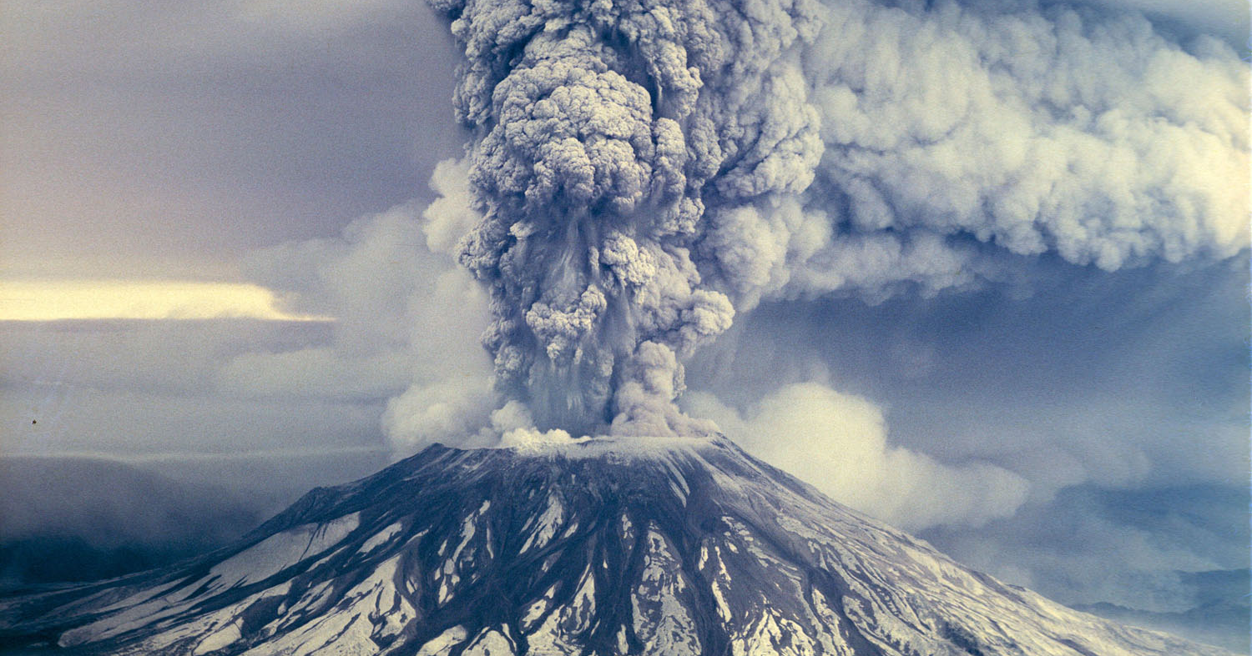
Questions & Discussion

Slide 38
Back-Up

Slide 39
Defining the Capability Needs - Architecture Tradespace

Slide 40
Modeling Study –
Modeling End-To-End Traceability for SBG (MEET-SBG)
MEET-SBG provides a framework to quantify L2 uncertainty and error propagation from surface to atmosphere to sensor, and the roles of retrieval methods to support end-to-end traceability of SBG.
The modeling activity is a collaboration between JPL, ARC, GSFC, DOE-BNL, industry, academic institutions, and non-profit organizations. Tasks will be re-evaluated throughout the study to align with the direction and needs of SBG.
MEET-SBG tasks include:
VSWIR uncertainty quantification via the SBG Hypertrace software package for representative cases of SBG focal areas
TIR uncertainty quantification via TEUsim instrument modeling approach for representative cases of SBG focal areas
Land-surface model improvements
Regional to global scale Observing System Simulation Experiment (OSSE) to evaluate Simulation of SBG spectra from existing hyperspectral and multispectral instruments
Engaging and advancing model theoretical algorithms to incorporate SBG L3 products
Providing SBG modeling and evaluation (HYPERTRACE and TEUsim) tools to the research and applications community

Slide 41
Data Pathfinder Study - SBG Space-based Imaging Spectroscopy and Thermal pathfindER (SISTER)
The purpose of SISTER is to prepare the science community for SBG products, and identify and reduce risks in the ground segment.
SISTER is an active collaboration between JPL, ARC, GSFC, industry, academic institutions, and non-profit organizations.
The proposed SISTER tasks, which will be re-evaluated throughout the study to align with the direction and needs of SBG, include:
Adapt and refine existing workflows and architectures as prototype(s) for the SBG science data system;
Examine existing atmospheric correction algorithms for standardized use in a global context for SBG target objectives*;
Examine L2b and L3 algorithm robustness for standardized use in a global context;
Produce pseudo-SBG datasets and identify algorithm and data system challenges for at-scale global production;
Distribute large pseudo-SBG datasets to the user community for evaluation;
Deliver an assessment of approaches for data product calibration and validation and make recommendations to the SBG project, and international partners, regarding value, cost and risk of cal/val approaches for SBG science focus areas;
Educate a new generation of users to VSWIR and TIR data;
Develop an early engagement strategy plan.
*SBG target objectives include terrestrial and marine ecosystems, geology, snow/ice, thermal, and other potential opportunities.

