Slide 1



2017 NRC Decadal Survey: Surface Biology & Geology Designated Observable
Dave Schimel, JPL
Ben Poulter, GSFC

Slide 2
Acknowledgements
Surface Biology and Geology Study Plan team & affiliates:
  Multi-Center: NASA HQ, NASA JPL, NASA Langley, NASA GSFC, NASA AMES
  Academia: University of Wisconsin, Boise State University, Caltech
  Study Plan: Dave Schimel, David R Thompson, Betsy Middleton, Natasha Stavros, Kerry Cawse-Nicholson, Phil Townsend, John Chron, Dave Bearden, Kevin Turpie, Nancy Glenn, Stephanie Uz, Jeff Luvall, Chip Miller, Ryan Pavlick, Jamie Nastal, Kurt Thome, Woody Turner, Dave Jarrett, Christine Lee, Ahn Nguyen, Ian Brosnan, Tony Freeman, Shannon Zareh
  Working Groups: Over 400 people engaged

Slide 3
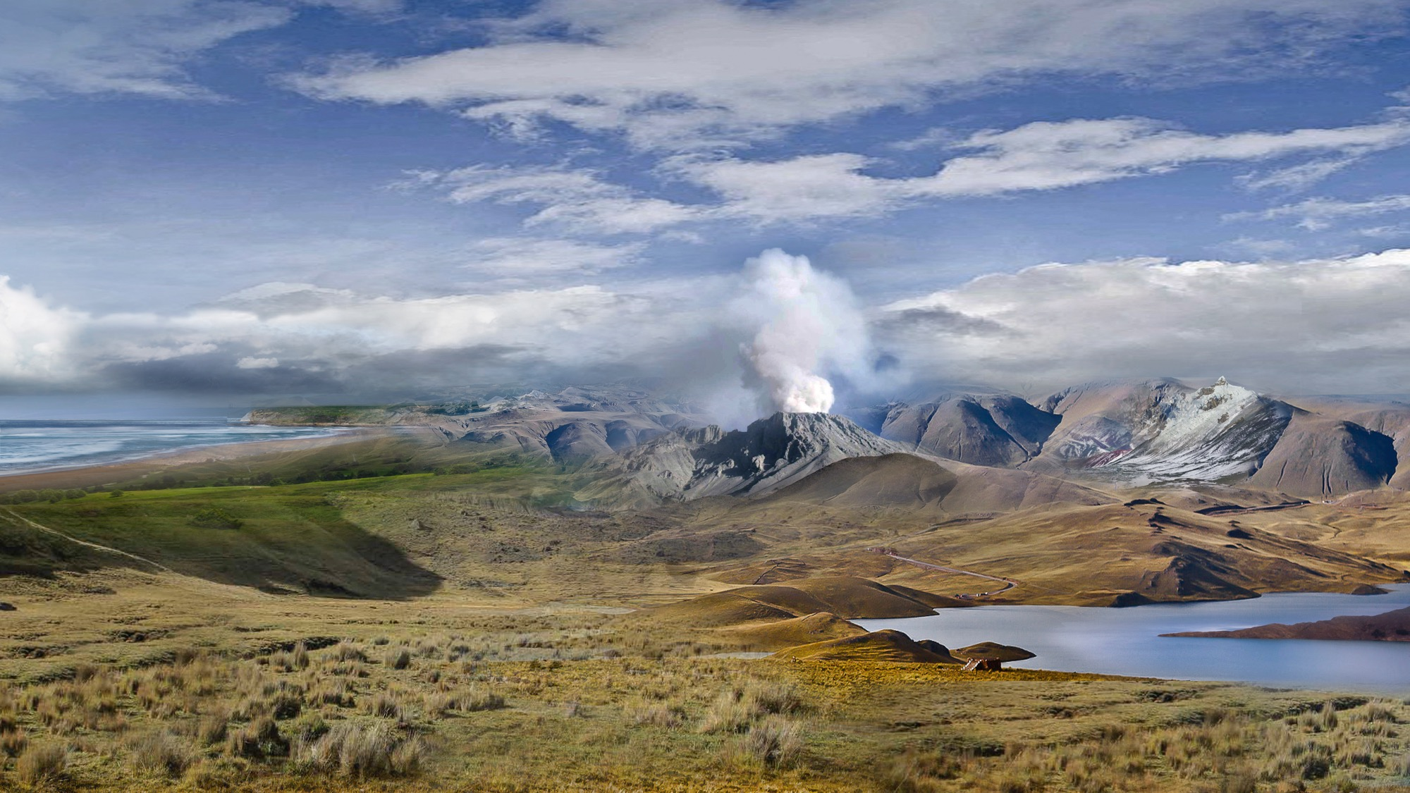
Mission Study on Surface Biology and Geology
SBG Science: Objectives from 5 Decadal Survey Focus Areas
Variability of the land surface and the fluxes of water, energy and momentum
Flows of energy, carbon, water, and nutrients sustaining the life cycle of terrestrial and marine ecosystems
Composition and temperature of volcanic products immediately following eruptions
Snow accumulation and melt
Inventory the world’s volcanos
The global carbon cycle and associated climate and ecosystem impacts
Monthly terrestrial CO₂ fluxes at 100 km scale
Land and water use effects on evapotranspiration
Functional traits and diversity of terrestrial and aquatic vegetation
Water balance from headwaters to the continent

Slide 4
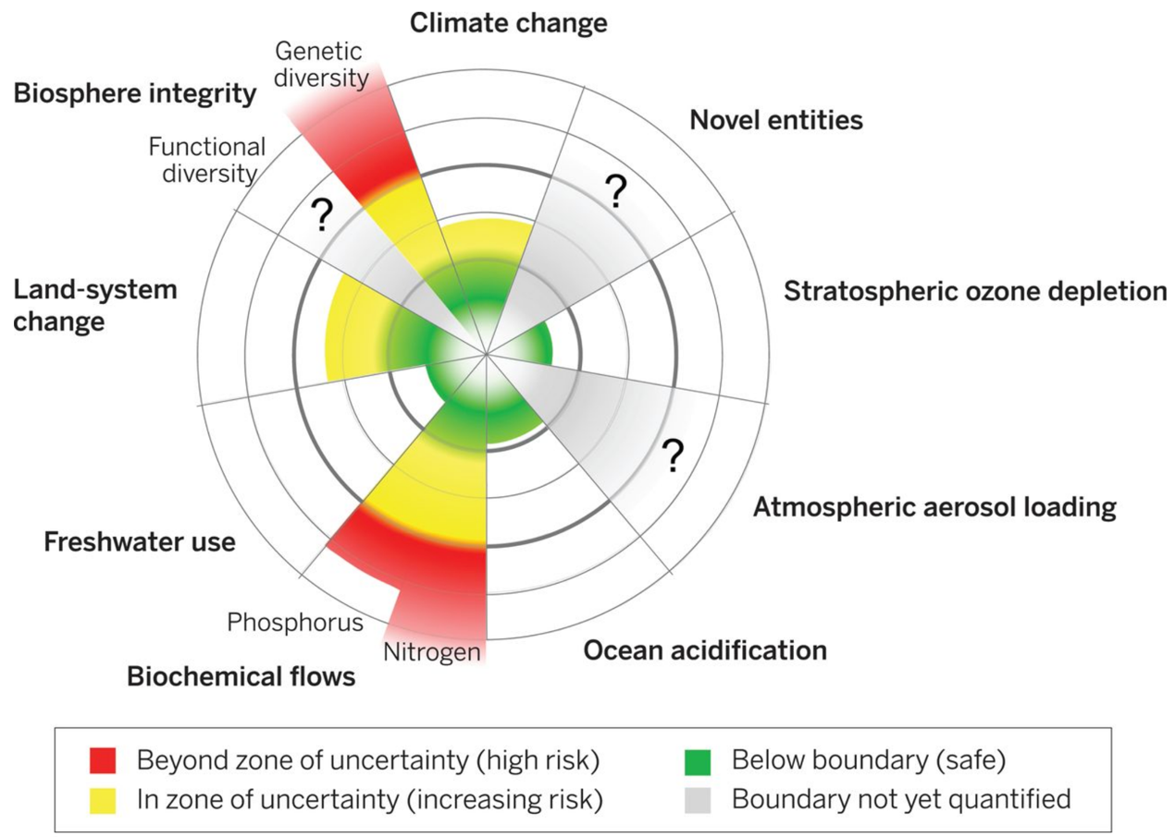
New generation of tools are required to monitor and understand the Earth system
Planetary Boundaries
Rockstrom et al. 2015

Slide 5

NASA EARTH FLEET
NISAR 2020
TROPICS (6) 2020
LANDSAT-9 2020
SENTINEL-6A/B 2020, 2025
OPERATING & FUTURE THROUGH 2023
TSIS-2 2020
SWOT 2021
PREFIRE (2) 2022
MAIA 2022
GEOCARB 2022
PACE 2022
INVEST/CUBESATS
RAVAN 2016
RainCube 2018
CSIM 2018
CubeRRT 2018
TEMPEST-D 2018
CIRiS 2019
HARP 2019
CTIM*
HyTI*
SNoOPI*
NACHOS*
* Launch date TBD
GLIMR ~2026
TEMPO 2022
ICESAT-2 2021
GRACE-FO (2) 2023
CYGNSS (8) 2020
NISTAR, EPIC (DSCOVR/NOAA) 2020
ISS INSTRUMENTS
EMIT 2021
CLARREO-PF 2020
GEDI 2020
SAGE III 2020
OCO-3 2022
TSIS-1 2023
ECOSTRESS 2020
LIS 2020
SORCE 2020
CLOUDSAT 2021
TERRA >2021
AQUA >2022
AURA >2022
CALIPSO >2022
GPM >2022
LANDSAT 7 (USGS) ~2022
JPSS-2, 3 & 4 INSTRUMENTS
OMPS-Limb
LANDSAT 8 (USGS) >2022
OCO-2 >2022
(PRE) FORMULATION
IMPLEMENTATON
PRIMARY OPS
EXTENDED OPS
OSTM/JASON 2 (NOAA) >2022
SMAP >2022
09.10.19
SUOMI NPP (NOAA) >2022

Slide 6

NRC Recommendations: Designated Observables

Slide 7

Surface Biology and Geology (SBG)
Leverages HYSPIRI pre-formulation study (HSI VSWIR+TIR mission concept)
Capabilities derived from the Decadal Survey and shown in the SATM
Three year Architecture Study Plan kicked off in August 2018
Global (mow-the-lawn), Event (pointing) and Change Detecting
Performance Parameters | Spectral Range | Spectral | SNR or NeDT | GSD | Revisit | Coverage | Local Time for Acquisition
VSWIR | 0.35 or 0.4 to 2.5µm | Resolution: 10nm or better Coverage: Continuous | SNR: VNIR: >400 SWIR: >250 | 30-45m | 2-16 days | Global | 10:30am to 1:30pm
TIR | 8 to 12µm 3 to 5µm | Bands: >5 desired | NEdT: <0.2 K | 40-60m | 1-7 days | Global | Can vary across the diurnal cycle

Slide 8
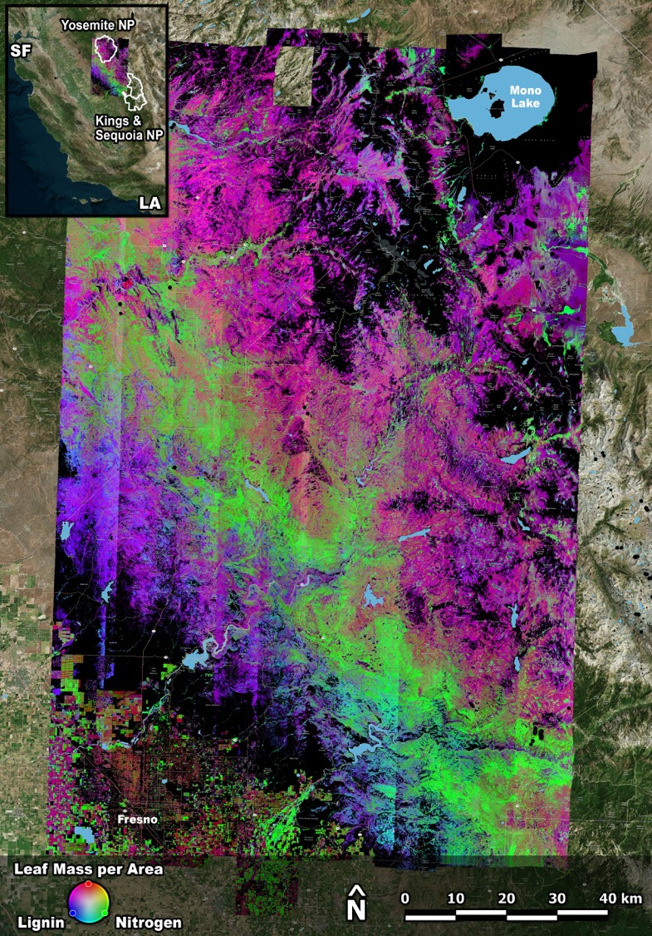
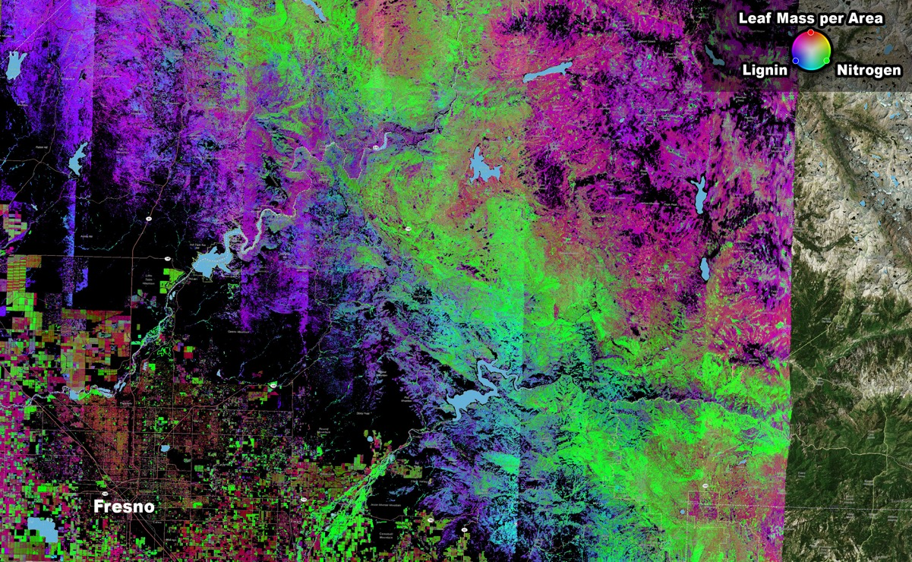
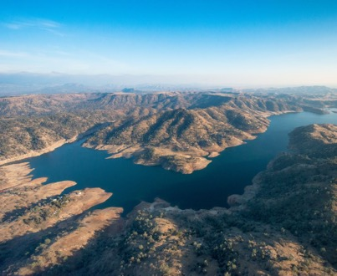
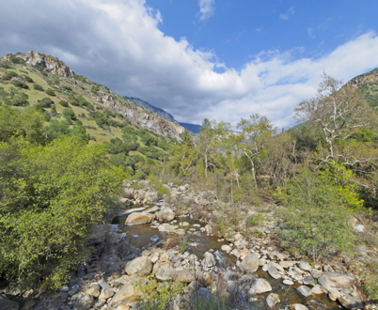
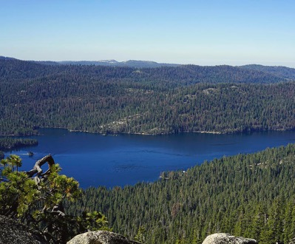
AVIRIS Maps Plant Functional Diversity
Millerton Lake
Kirch Flat
Huntington Lake
https://ca.reel-scout.com/up_images/9/2962389.jpg
http://360panos.com/panos/BalchCampBridge_One.php
https://images.fineartamerica.com/images/artworkimages/mediumlarge/1/huntington-lake-dale-matson.jpg

Slide 9
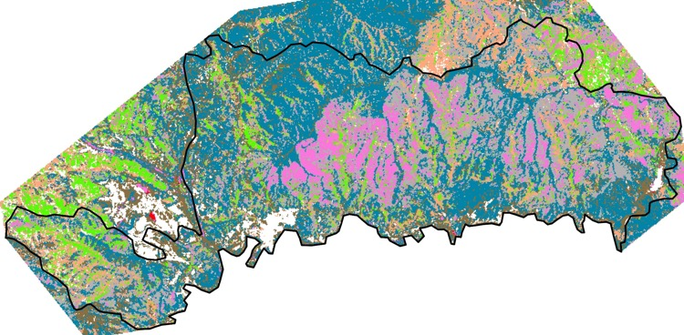
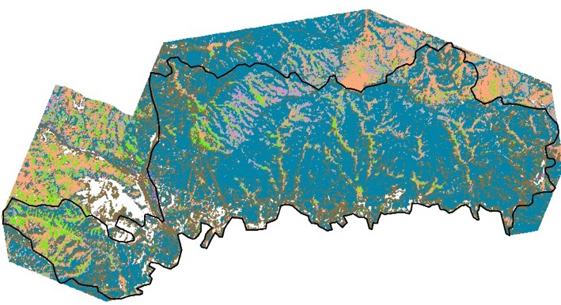
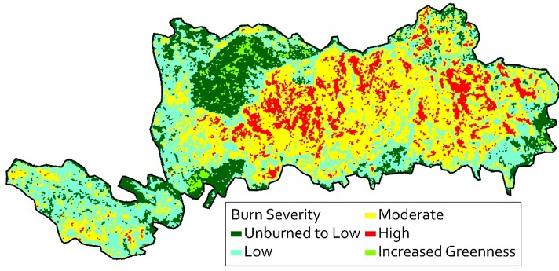
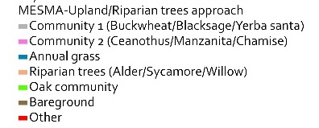
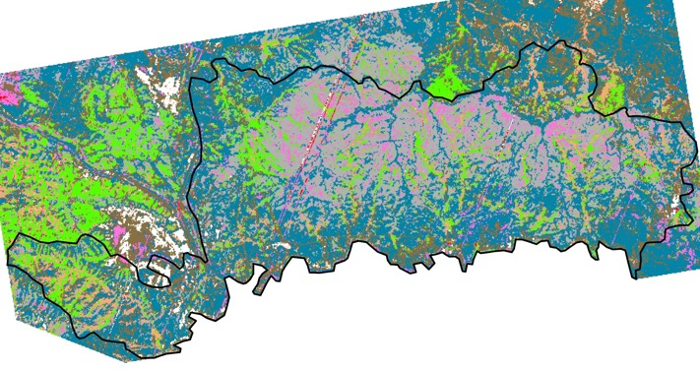
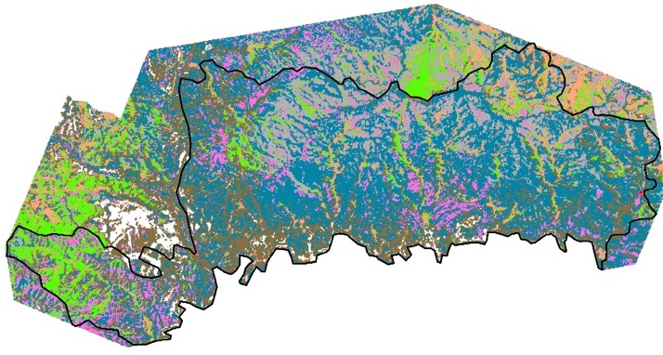
Sayre 2008
Sayre 2014
Imaging Spectroscopy reveals post-fire succession
Sayre Fire, 2008
Sayre 2018
Sayre 2016

Slide 10
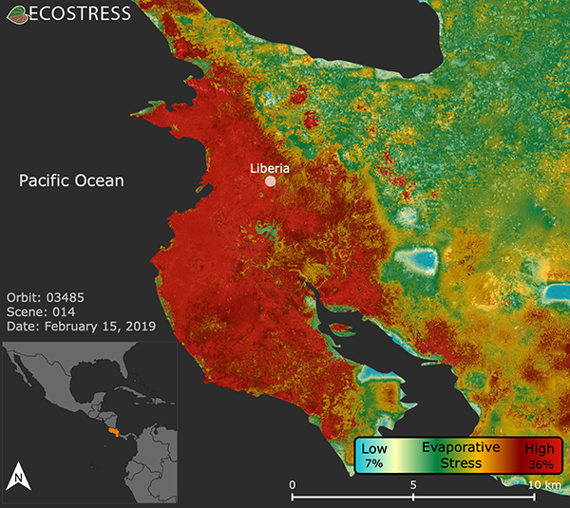
Evapotranspiration and water stress

Slide 11
Surface Minerology:
Cuprite, Nevada
Spectroscopic Unmixing

Slide 12
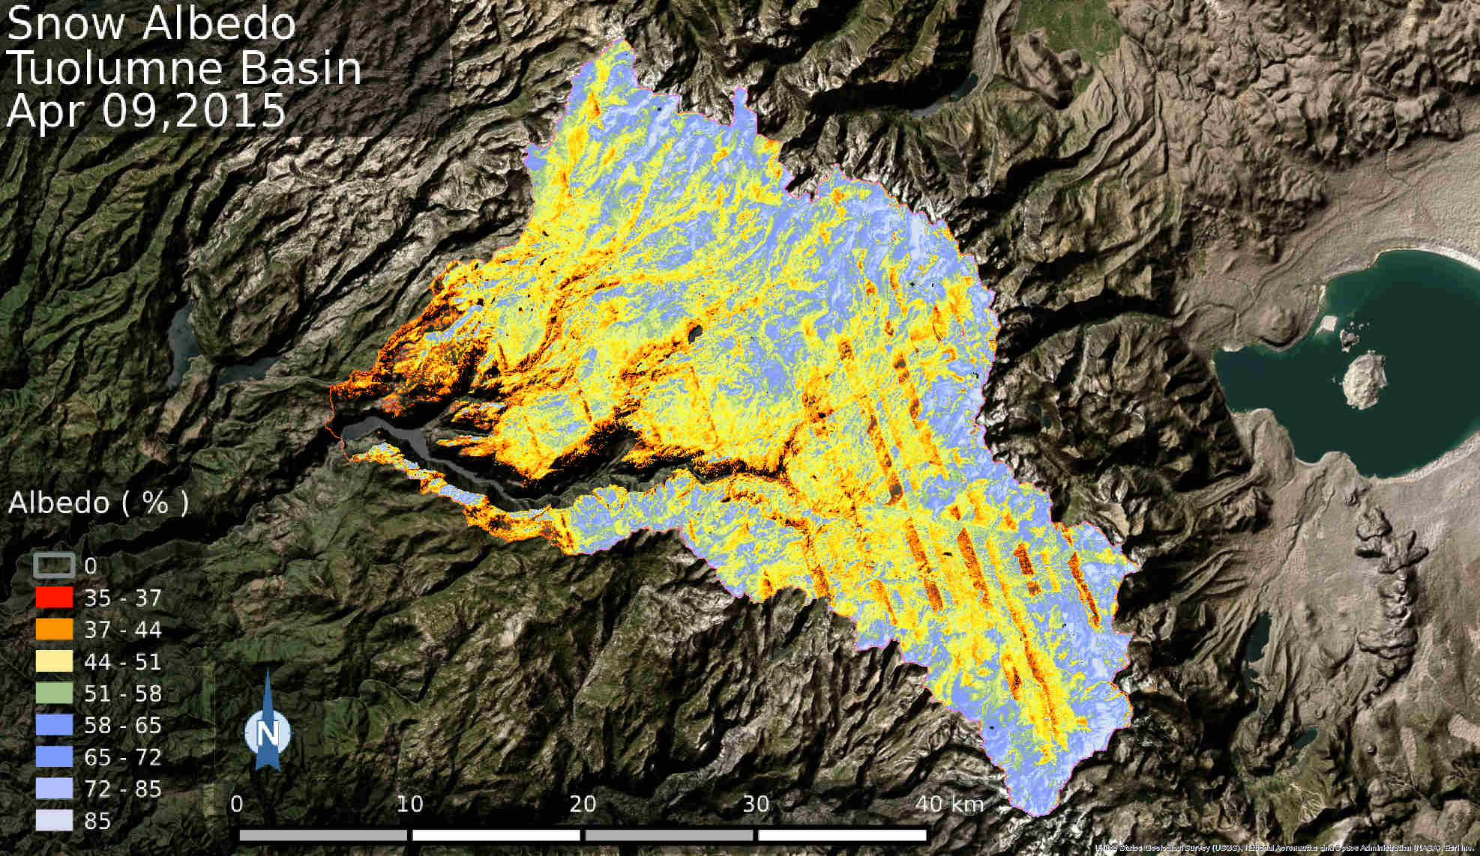

Slide 13
Benthic Cover
CORAL Earth Venture

Slide 14
Wildfire: thermal imagery of King Wildfire
Sierra Nevadas

Slide 15
Volcanic Eruptions
Ubingas, Andes

Slide 16
SBG Science across five focus area and two critical spectral regions

Slide 17
SBG Team
NASA HQ
Marissa Herron
Woody Turner
Ben Phillips
Laura Lorenzoni
Center Executive Steering Committee
Ryan Spackman- NASA ARC
James Irons- NASA GSFC
Randy Friedl- JPL Chair
David Young- NASA LaRC
Gary Jedlovec- NASA MSFC
Research & Applications Team
Dave Schimel- JPL, Coordinator
Ben Poulter- GSFC
Science Steering Committee
Working Groups:
Algorithms
Cal/Val
Modeling
Applications
SBG Study Coordinator
Jamie Nastal- JPL
International Collaborations Coordinator
Chip Miller- JPL
Architecture Teams
Phase 1: Identify Candidate Architectures
Tony Freeman- JPL, Lead
Ben Poulter- GSFC, Deputy Lead
Phase 2: Architecture Assessment
David Bearden- JPL, Lead
Jon Chrone- LaRC, Deputy Lead
Phase 3: Architecture Design
Amit Sen- JPL, Lead
Kurt Thome- GSFC, Deputy Lead
Architecture Formulation Team
Kelley Case- JPL,
Co- Coordinator
Belgacem Jaroux- ARC, Co-Coordinator
(A-Team Workshops for Candidate architectures,
Architecture Assessment and Detail Architecture)
Cost Estimation Team
Jim Hoffman-JPL,
Co-Coordinator
Jordan Klovstad- LaRC, Co-Coordinator
Deliverable Preparation
Phase 4: Final Report, MCR material
Jamie Nastal- JPL, Lead

Slide 18
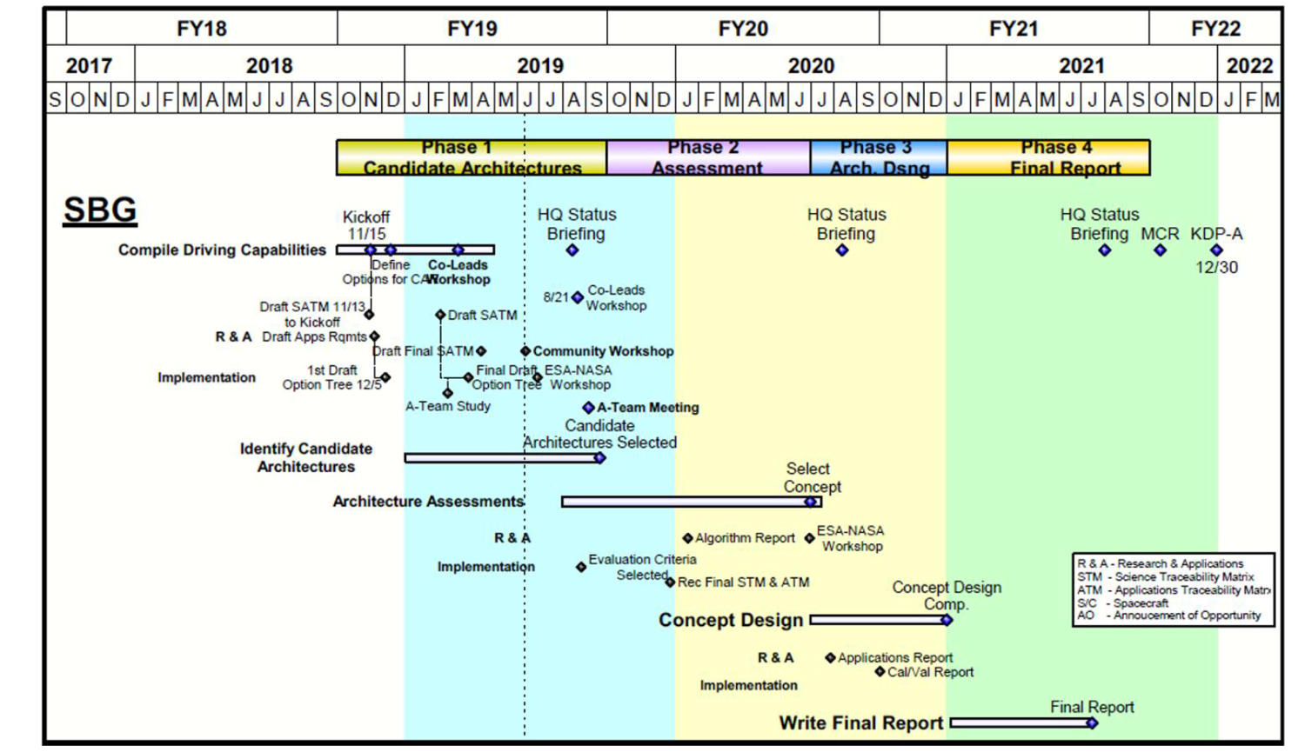
SBG Study Plan: Four Phases

Slide 19
Funnel - from “Many” to “Few”
Potential Options
Large number of permutations (60-80+)
Feasible Options
Perform mission-level design (e.g. Team-X)
Promising Options
Small number (1-3)
Provide to HQ with supporting information
Broad exploration of potential trade space
High-level metrics used to consolidate and prune
Multiple Options (~10-20)
Assess using parametrics and analogy-based models
Create hybrids and combinations
Use performance models to discriminate
Identify primary drivers and play against SATM
~60-80+
Number of Observing System Architectures
~10-20
~1-3
Phase 1
Phase 3
Oct-Dec 2019
Jan-Mar 2020
Apr-Jun 2020

Slide 20
SBG R&A: Working Groups & Engagement
Architecture Team
Value Framework
RA Steering Committee
Science priorities
Science and Applications Traceability Matrix (SATM)
Science and Applications Value Metrics
Algorithm WG
Core and extended algorithm list
Algorithm maturity assessment
End-to-end workflow
Algorithm SNR needs
Cal/Val WG
Identify Cal/Val elements for calibration and validation (Cal/Val)
Provide Cal/Val elements for architecture
Applications WG
Applications traceability matrix
Latency assessment and metric
SOW for applications contractor
Modeling WG
End-to-end modeling framework
Assessment of model component maturity
Uncertainty quantification activity

Slide 21
Candidate Architecture Implementation Approach
Feb 2019
Jun-July 2019
Aug 2019
SATM 2.0
SATM n.0
R&A
SATM 1.0
Capability Classes
Value Framework
ESTO investments
Current & Planned Systems
Notional Instruments
RFI Responses
INSTRUMENTS
Instrument Model(s)
Program of Record
Concept of Operations
Architecture Options
Platform Classes
OBSERVING ARCHITECTURE
Orbits
International Partner Options
Downlink Strategies
Architecture Building Blocks
Costing Assumptions
Launch Vehicles
Cost Model
A-Team Session (JPL)
HyperSpectral Workshop (Frascati)
Architecture Workshop
(ARC)
EVENTS
All-Hands
Meeting (DC)

Slide 22
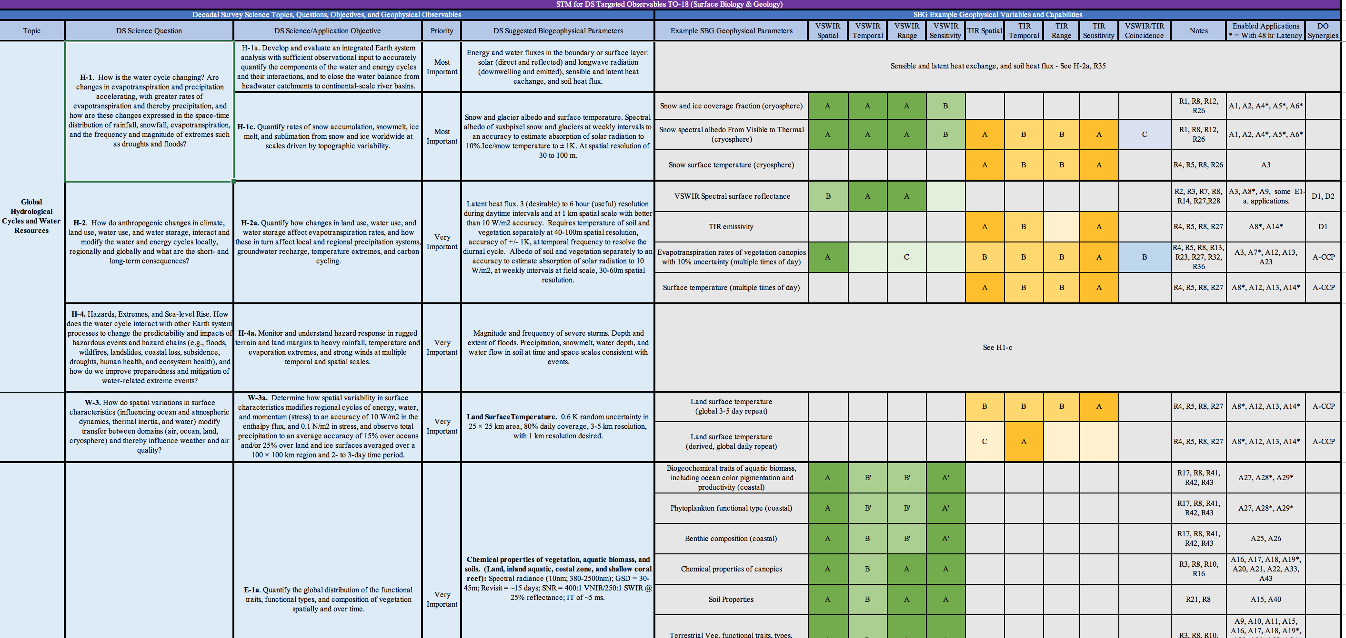
SBG Phase 1: Linking SATM w obs. capabilities

Slide 23
SBG has 9 core geophysical data product suites.
Each suite is produced by a single executable code but may have multiple subproducts
Users and selected science team members may produce additional products
Science Priorities Addressed | Category | Name of Product Generation Executable | Subproducts
E-1, E2, E-3 | Vegetation | Vegetation Traits | Nitrogen, pigments, LMA, water content
H-2, H-1 | Vegetation | Evapotranspiration | ET, evaporative stress index
E-3 | Land Cover | Proportional Cover | Photosynthetic and non-photosynthetic vegetation, substrate, snow/ice
S-1, E-1, S-2 | Geology | Substrate (soils, minerals) composition | Mineral area fractional abundance, soil type
S-1 | Volcanic | Volcanic Gases and Plumes | SO₂ concentration, volcanic ash, SO₄ aerosols
E-1 | Aquatic | Aquatic Biogeochemistry | Pigments, particulates, chromophoric organic matter, sediments
E-3 | Aquatic | Aquatic Classification | Phytoplankton functional type, benthic cover, coral
S-1 | Volcanic | High temperature features | Volcanic temperature anomalies, wildfire
H-1, H-4 | Snow | Snow albedo | Snow albedo, snow grain size

Slide 24
SBG Phase 1: Linking SATM w obs. capabilities
Capability Code | VSWIR Spatial | VSWIR Temporal | VSWIR Range | VSWIR Sensitivity | TIR Spatial | TIR Temporal | TIR Range | TIR Sensitivity | VSWIR/TIR Coincidence
A | ≤30 m | ≤8 days for global coverage* | ≤380 - ≥2500 nm, @ ≤10nm | SNR ≥400 VNIR, SNR ≥250 SWIR, accuracy ≤10% | ≤30 m | ≤1 day for global coverage* | ≥5 bands in 8-12 um, ≥ 1 band in 3 -4.5 um | ≤1K Absolue, ≤0.2K NeDT / band | Simultaneous within 30 seconds
B | ≤60 m | ≤16 days for global coverage* | ≤380 nm - ≥1000 nm, @ ≤10nm | ≤10% Absolute accuracy | ≤60 m | ≤3 days for global coverage* | ≥5 bands in 8-12 um | ≤1.5% Absolute, <1K NeDT / band | On same day
C |  |  | VNIR multiband |  | ≤100 m | ≤5 days for global coverage* | ≥3 bands in 8-12 um |  | VNIR within 3 days
*As well as applications requirements (i.e., data latency) & DO synergies

Slide 25
SBG Phase 1: Linking SATM w obs. capabilities

Slide 26
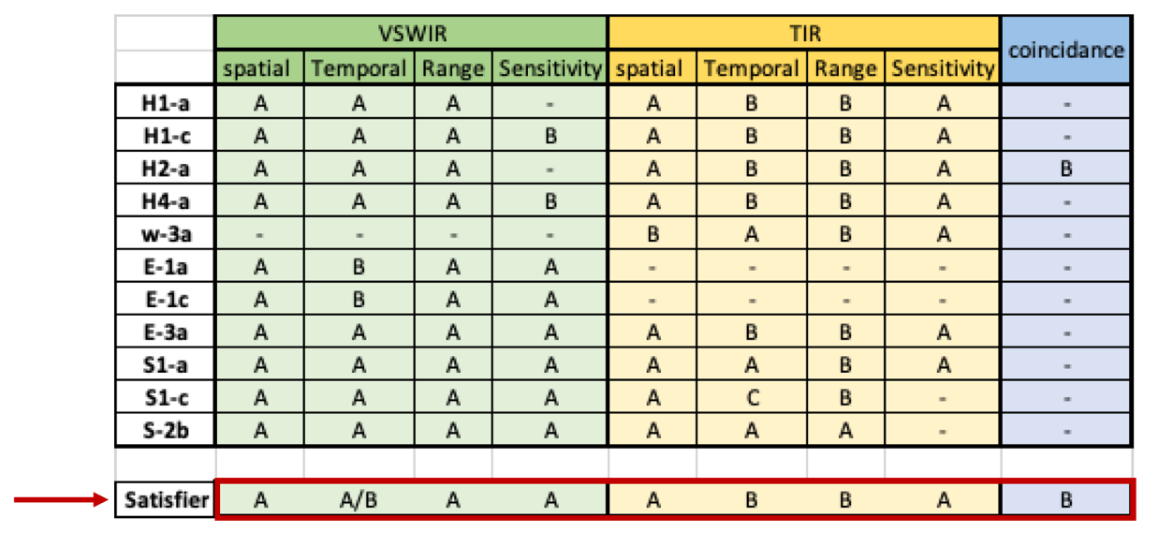
SBG Phase 1: Linking SATM w obs. capabilities
VSWIR
Spatial | Revisit | Range | Sensitivity
94% A | 54% B | 76% A | 64% A
TIR
Spatial | Revisit | Range | Sensitivity
77% A | 46% B | 46% B | 54% na (46% A)

Slide 27
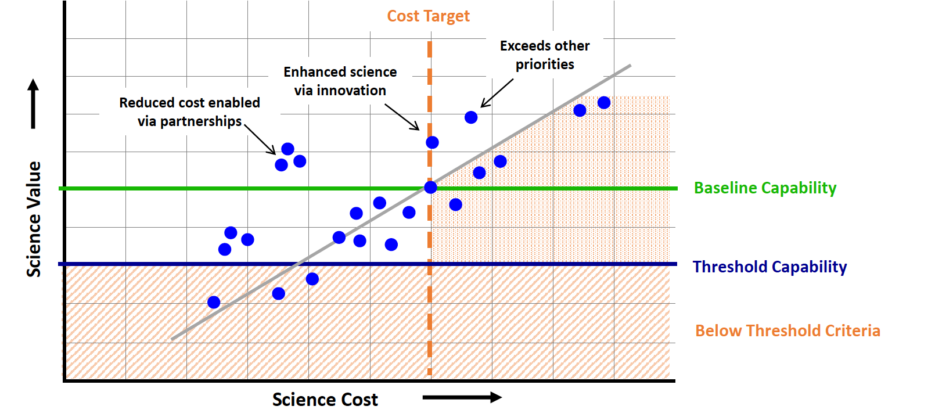
SBG Phase 2: Value Framework
Scoring of individual architectures based on science value (i.e., meeting capabilities in SATM, OSSEs etc.), cost ($650M constraint), risk (e.g., TRL)

Slide 28
International/Industry Engagement
Opportunities to expand scientific knowledge, participation in identifying observing architecture candidates, potential partnerships for mission implementation
SBG International Participation:
  Japan: HISUI sensor team- VSWIR from ISS precursor data (2019 launch)
  Germany: DLR/DESIS- VSWIR from ISS precursor data (2018 launch)
  ASI: PRISMA precursor data (2019 launch), potential partnership TIR free flyer concept
  ESA: Copernicus/CHIME/LSTM- coordination for VSWIR and TIR free flyer data
  CNES: TIR collaboration
Industry Participation
  RFI Responses
  Community Assessment Report

Slide 29
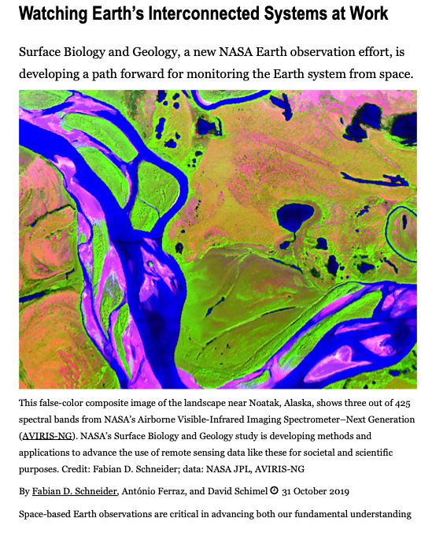
Working Groups are responsible for engagement and transparency
Working Groups have a core team but membership is open, prospective members contact co-leads and receive dial-in info, schedules etc,
Working Group Co-Leads organize and participate in SBG community and international workshops (June in Washington, DC and Frascati Italy),
Working Group Co-Leads give frequent SBG presentations at national and international meetings,
Working Group members (Post-Docs) wrote the EOS workshop report for the June DC meeting (soon to appear, see below).
EOS Article

Slide 30
SBG R&A: Working Groups & Engagement
RA Steering Committee
Dave Schimel (JPL) & Ben Poulter (GSFC)
Liane Guild (ARC), Jeff Luvall (MSFC), David Thompson (JPL), Rob Green (JPL), Simon Hook (JPL) & Working Group Co-Leads
Algorithm WG
Phil Townsend (UW-Madison)
Kerry Cawse-Nicholson (JPL)
Cal/Val WG
Kevin Turpie (GSFC)
Ray Kokaly (USGS)
Applications WG
Jeff Luvall (MSFC) Christine Lee (JPL)
Stephanie Uz (GSFC)
Modeling WG
Ben Poulter (GSFC)
Weile Wang (ARC)
Shawn Serbin (BNL)
400 members overall

Slide 31
Algorithms Working Group
Phase 1 Key Activities / Deliverables
Identified 200 products across:
  Aquatic
  Geology
  Vegetation
  Snow
  Thermal
Identified algorithm needs SNR, ancillary data, pre-processing, etc.
Goals
Support mission concept development by assessing existing algorithms, identifying gaps and opportunities
Consider available algorithms for science and applications, their uncertainty and input requirements
Prepare prototype workflow for sample products
Phase 2 Activities / Deliverables
Consider whether any given algorithm should be applied globally or to a subset
Use and acquire precursor airborne and space-based imagery to demonstrate prototype level 3 and level 4 products
Prepare a final report recommending algorithms for each product along with a list of required ATBDs
Joining the SBG-Apps WG
130+ working group members
Biweekly telecons (20 – 60 participants)
50+ contributors to Team Drive
200+ products have been suggested by the community!
To join, email kcawseni@jpl.nasa.gov

Slide 32
Calibration and Validation Working Group
Goals
Develop a calibration and validation (Cal/Val) strategy that:
  Calibrates SBG at-sensor measurements to assure uncertainty targets are met
  Validates all geophysical quantities derived from surface spectral reflectance
Provide input into the value framework of candidate architectures
Phase 1 Key Activities / Deliverables
Identify potential Cal/Val concept elements
Report key Cal/Val elements tied to architectures
Identify key reference data sets required for algorithms (especially Levels 0 and 1
Explore Cal/Val strategies of POR assets (e.g., Landsat, Hyperion, EOS, NPP) and new resources (e.g., GLAMR)
Develop recommendations for international collaboration
Phase 2 Activities / Deliverables
Continue working with other WGs to identify target observation uncertainties
Describe validation strategies and potential resources for geophysical surface measurements
Develop tiered Cal/Val strategies
Devise scoring system to value calibration options supported by candidate architectures
Joining the SBG-Apps WG
Members include calibration teams at NIST, NASA, USGS and private sector
  Will grow in Phase 2 to include surface measurement organizations
Meeting every 2-3 months in Phase 1, increase in Phase 2
Supporting regular meetings with Algorithm WG
To get engaged, email kturpie@umbc.edu

Slide 33
SBG Applications Working Group
Goals
Identify key applications, capability needs, latency, and data products
Characterize SBG communities of practice/potential and understand value-added of SBG data products
Engage SBG community via joint activities, workshops, and design/dissemination of tailored SBG data
Phase 1 Key Activities / Deliverables
Formation of applications team, including thematic subgroups
Applications Traceability Matrix (95 unique applications)
Integration of ATM applications as inputs into the SATM and value framework
Strategy for developing the SBG CAR
Phase 2 Activities / Deliverables
Monthly WG meetings
Research Triangle Institute (RTI) contract to quantify value of information from SBG and assess private sector community of practice
Produce Science Value vs Cost Charts that include applications value
Outline and begin to draft CAR
Joining the SBG-Apps WG
125+ members from public and private sector, universities, NGOs, and government (US/non-US, federal, state, regional and local
Bi-weekly telecons in Phase 1, monthly starting in Phase 2
To join, sign up: tinyurl.com/sbgapplicationswg

Slide 34
SBG Modeling Working Group
Goals
Provide a modeling environment for end-to-end traceability activities
Identify geophysical modeling requirements for VSWIR and TIR applications
Expand the existing research community involved with hyperspectral VSWIR and multi-spectral TIR radiative transfer modeling and model-data integration
Phase 1 Key Activities / Deliverables
Survey modeling community about radiative transfer modeling tools for aquatic and land ecosystems
Develop framework for Observing System Simulation Experiments (OSEE) for VSWIR and TIR applications
Finalize protocol for community SBG simulation experiment to provide architecture Figures of Merit
Phase 2 Activities / Deliverables
Fall monthly webinars on modeling results
Community simulations in support of SBG – protocol released mid-September
Figures of Merit and other uncertainty quantification activities available February to March 2020
Expansion of extensive global Observing System Simulation Experiment (OSSE) using modified land-surface and ocean biogeochemistry models
Joining the SBG-Modeling WG
100+ members from public & private sector, universities, NGOs, government (US & non-US)
Monthly meetings
To join, email benjamin.poulter@nasa.gov
To participate, https://sbg-modeling.slack.com/

Slide 35
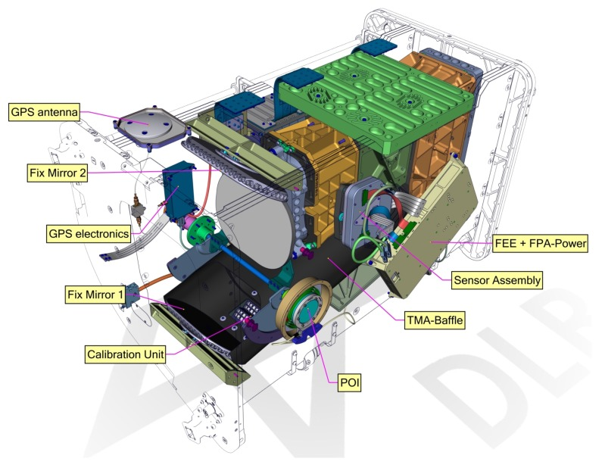
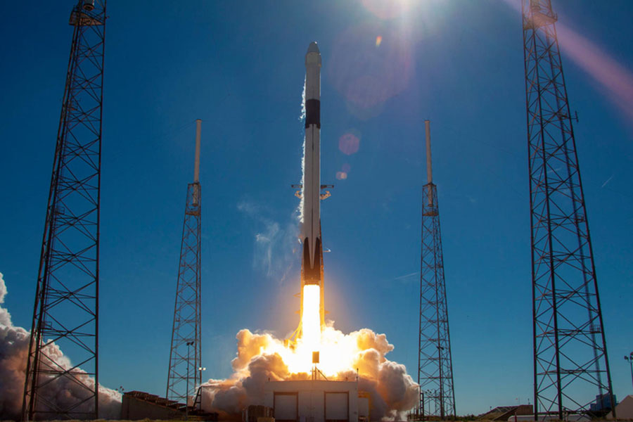

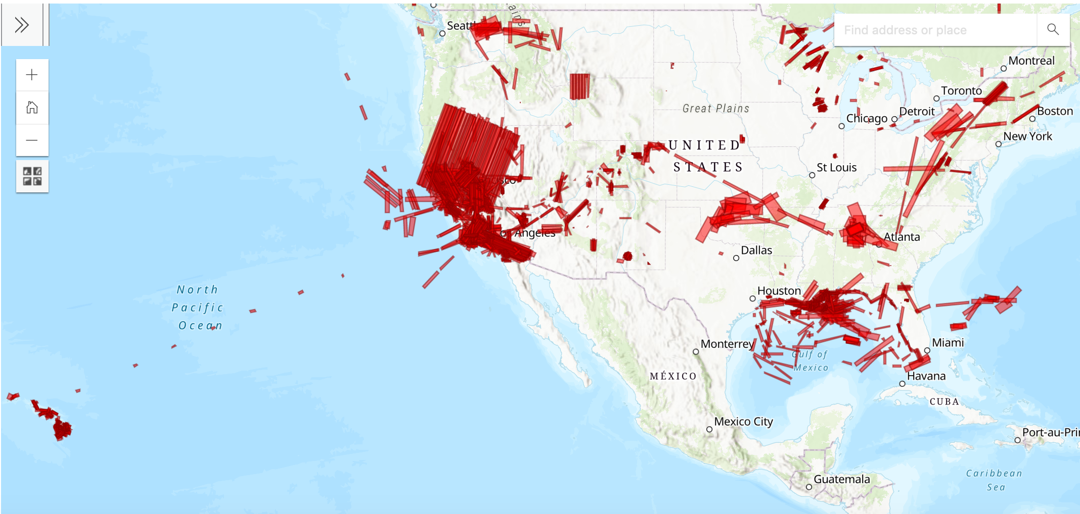
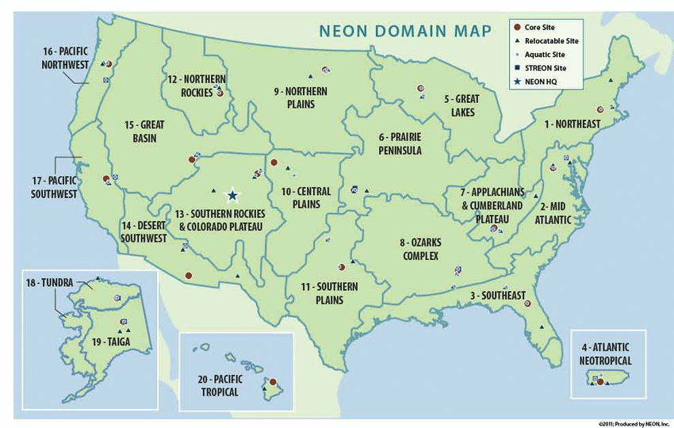
SBG -> To Mission Concept Review Oct 2021
Website: https://sbg.jpl.nasa.gov/
Community Workshop: May 2020
Join a WG: email benjamin.poulter@nasa.gov

