Slide 1



Architecture Studies for NASA’s Surface Biology and Geology (SBG) Targeted Observable
Shannon Zareh, Ben Poulter, Anthony Freeman, David Schimel, David Bearden, Jonathon Chrone, David Thompson, Elizabeth Middleton, Kevin Turpie, Charles Miller, Nancy Glenn

Slide 2

Overview
Architecture Formulation Overview
Implementation Approach
Instrument Modeling
Architecture Trade Space
Ongoing work in Phase II

Slide 3
SBG and Architecture Formulation
NASA charged the US National Academy of Sciences to recommend 2017-2027 observing priorities. In the observing systems priorities, Surface Biology and Geology (SBG) has been recommended as one of the targeted observables a Designated Observable. The candidate measurement approach is hyperspectral imagery in the visible and shortwave infrared, multi or hyperspectral imagery in the thermal IR.
SBG Architecture Formulation identifies and assesses candidate observing systems based on science, cost and risk studies and and provides a concept to HQ.

Slide 4
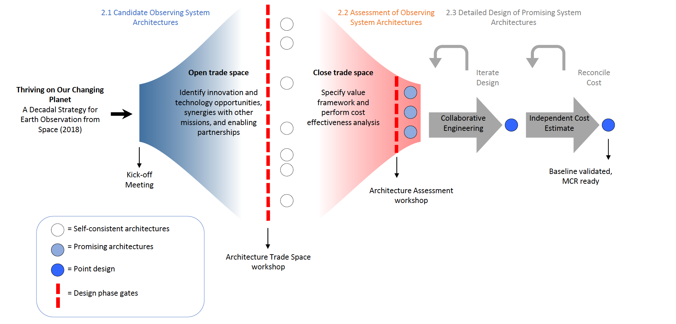
Architecture Formulation Approach

Slide 5
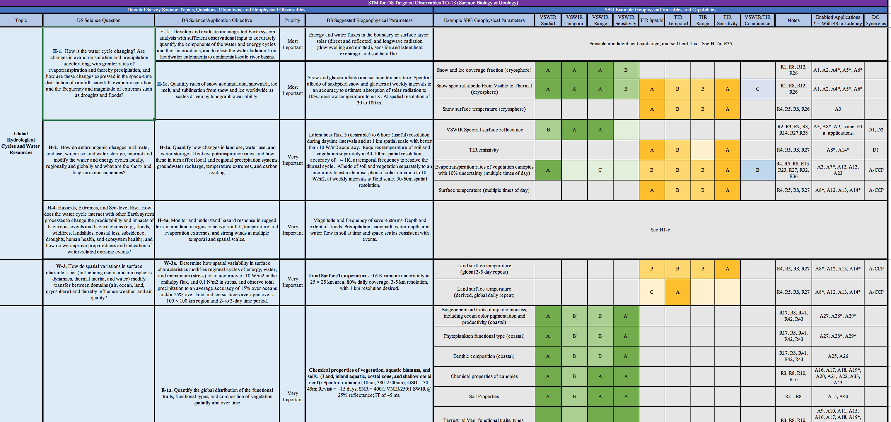
Linking SATM with Capabilities

Slide 6
SATM Capability Codes
Capability Code | VSWIR |  |  |  | TIR
 | Spatial | Temporal | Range | Sensitivity | Spatial | Temporal | Range | Sensitivity | VSWIR/TIR Coincidence
A | ≤30 m | ≤8 days for global coverage* | ≤380 - ≥2500 nm, @ ≤10nm | SNR ≥400 VNIR, SNR ≥250 SWIR, accuracy ≤10% | ≤30 m | ≤1 day for global coverage* | ≥5 bands in 8-12 um, ≥ 1 band in 3 -4.5 um | ≤1K Absolue, ≤0.2K NeDT / band | Simultaneous within 30 seconds
B | ≤60 m | ≤16 days for global coverage* | ≤380 nm - ≥1000 nm, @ ≤10nm | ≤10% Absolute accuracy | ≤60 m | ≤3 days for global coverage* | ≥5 bands in 8-12 um | ≤1.5% Absolute, <1K NeDT / band | On same day
C |  |  | VNIR multiband |  | ≤100 m | ≤5 days for global coverage* | ≥3 bands in 8-12 um |  | VNIR within 3 days
Notes:
Science priorities
Science and Applications Traceability Matrix
Science and Applications Value Metrics

Slide 7
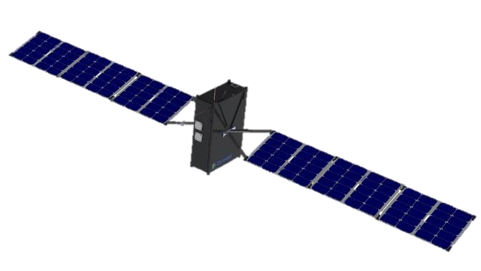


SBG Instrument Architecture Study
The instrument architecture study assesses the performance of the instruments based on radiometric calculation
The instrument performance is a function of the collected signal and noise sources
The VSWIR and TIR instrument scenario study was performed for various platforms:
  CubeSat, SmallSat, Medium Sat, Large Sat / Flagship
Solid angle
transmission
Signal = spectral radiance * A_{o} * Ω_{d} * δλ * (λ/hc)* albedo * cos(φ) ∗ T * t_{int} * η
Aperture
Spectral
resolution
Solar
Zenith Angle
Detector
QE
SNR = $\frac{signal}{\sqrt{signal+{Nd}^{2}+{Nr}^{2}+{Ne}^{2}+{Nq}^{2}}}$
pixel pitch
Focal length
solid angle:
Ω_{d} = (GSD/Alt)²
= (pitch/fl)²
Input parameters
output
Altitude
GSD
Optics F#
Pixel pitch
Detector array size
Spectral resolution
Telescope aperture
Telescope focal length
Signal throughput
SNR
Ground swath
Temporal rate
Slit width
Estimate
Instrument mass
Altitude = 705 km
Ground Sample
22.7 Mm separation
22 m
diameter starshade

Slide 8
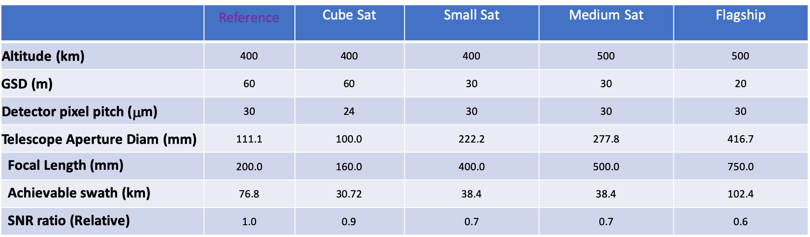
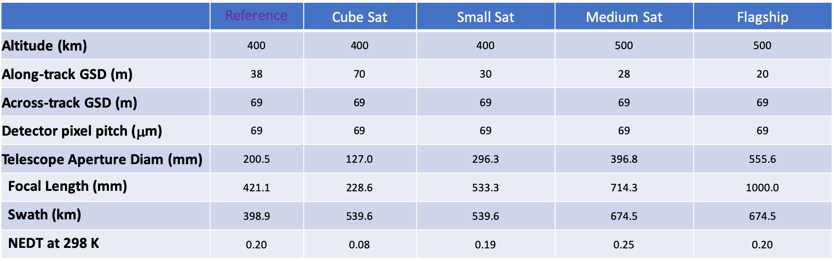
SBG Instrument Architecture Study
VSWIR Instrument Scenario Examples
(400 – 2500 nm, Hyperspectral, δλ 10 nm)
Instrument architectures include:
  Hyperspectral VSWIR
  Multi-band TIR
  Hyperspectral TIR
  Microbolometer
Instrument observation modes include:
  Pushbroom
    Hyperspectral VSWIR/TIR
  Whisk-broom
    Multiband TIR
Telescope aperture is the driving factor for the instrument mass and mission cost
Instrument sensitivity is studies relative to a well-characterized reference instrument and more in-depth modeling
Large format focal planes and multiple instruments/platforms can highly benefit the revisit rate and ground swath
TIR Instrument Scenario Examples
(8-12 μm, Multi-spectral, δλ 0.5 μ)

Slide 9
Architecture Trade Space Building Blocks
Options for Space-based Systems
Observing System Class
Launch Vehicle
# Platforms
Instrument Configuration
Calibration
Data Latency
Mission Duration
Flagship
Falcon-9 or Vulcan
1
VNIR
0.4 – 1.0 μm
OnBoard
High
3 yrs
Large-Class
Electron or Virgin
2
VSWIR
0.4 – 1.7 μm
Vicarious
Medium
5-7 yrs
Medium-Class
Secondary
Multiple
VSWIR
0.4 – 2.5 μm
Low
Small-Class
Vega or PSLV
TIR
Whisk-Push
Additional Features
Constellation
TIR
PushBroom
Off-nadir Pointing
International Contributions
Micro
bolometer
5 Classes
60 Variants
765 permutations
Flight Spares
Airborne Component
TIR
Hyperspectral
MOps Coordination
OnBoard Processing
Non-SBG instruments
Hosted Payloiad

Slide 10
Flagship Class Options
4 Variants; 60 possible permutations in total
Observing System Class
Launch Vehicle
# Platforms
Instrument Configuration
Calibration
Data Latency
Mission Duration
Flagship
Falcon-9 or Vulcan
1
VNIR
0.4 – 1.0 μm
OnBoard
High
3 yrs
Large-Class
Electron or Virgin
2
VSWIR
0.4 – 1.7 μm
Vicarious
Medium
5-7 yrs
Medium-Class
Secondary
Multiple
VSWIR
0.4 – 2.5 μm
Low
Small-Class
Vega or PSLV
TIR
Whisk-Push
Additional Features
Constellation
TIR
PushBroom
Off-nadir Pointing
International Contributions
TIR
Bolometer
Assume Flagship is in combination with ACCP
Potential international contribution
TIR
Camera
Flight Spares
Airborne Component
Non-SBG instruments
MOps Coordination
OnBoard Processing

Slide 11
SmallSat Class Options
16 variants; 324 possible permutations
Observing System Class
Launch Vehicle
# Platforms
Instrument Configuration
Calibration
Data Latency
Mission Duration
Flagship
Falcon-9 or Vulcan
1
VNIR
0.4 – 1.0 μm
OnBoard
High
3 yrs
Large-Class
Electron or Virgin
2
VSWIR
0.4 – 1.7 μm
Vicarious
Medium
5-7 yrs
Medium-Class
Secondary
Multiple
VSWIR
0.4 – 2.5 μm
Low
Small-Class
Vega or PSLV
TIR
Whisk-Push
Additional Features
Constellation
TIR
PushBroom
Off-nadir Pointing
International Contributions
TIR
Bolometer
VSWIR Vicarious Calibration only
Mission duration only guaranteed to 3 yrs
International Coordination with ESA and/or ASI and/or ISRO
TIR
Camera
Flight Spares
Airborne Component
Non-SBG instruments
MOps Coordination
OnBoard Processing

Slide 12
Hybrid Class Options
1
11 Variants
1
Flagship
+
Constellation
(VSWIR + TIR + ACCP inst.)
(8 VSWIR + 4 TIR cubesats)
2
Large-Class
+
Constellation
+
International Contributions
3
(8 VSWIR and/or 4 TIR cubesats)
(VSWIR + TIR)
(ESA CHIME
+ ASI TIR)
Medium-Class
Constellation
8
Small-Class
Constellation
4
+
+
9
(VSWIR + P/B TIR)
(4 TIR cubesats)
(1 VSWIR, 1 W/P TIR)
(4 TIR cubesats)
5
Small-Class
+
Constellation
(1 VSWIR, 1 W/P TIR)
(8 VSWIR + 4 TIR cubesats)
10
Small-Class
+
Constellation
6
Small-Class
+
Constellation
11
(1 W/P TIR)
(8 VSWIR and/or 4 TIR cubesats)
(2 VSWIR, 2 W/P TIR)
(4 TIR cubesats)
Small-Class
Constellation
+
International Contributions
7
+
+
International Contributions
(1 VSWIR)
(4 TIR cubesats)
(ISRO VSWIR platform)
(ESA CHIME
+ ASI TIR)

Slide 13
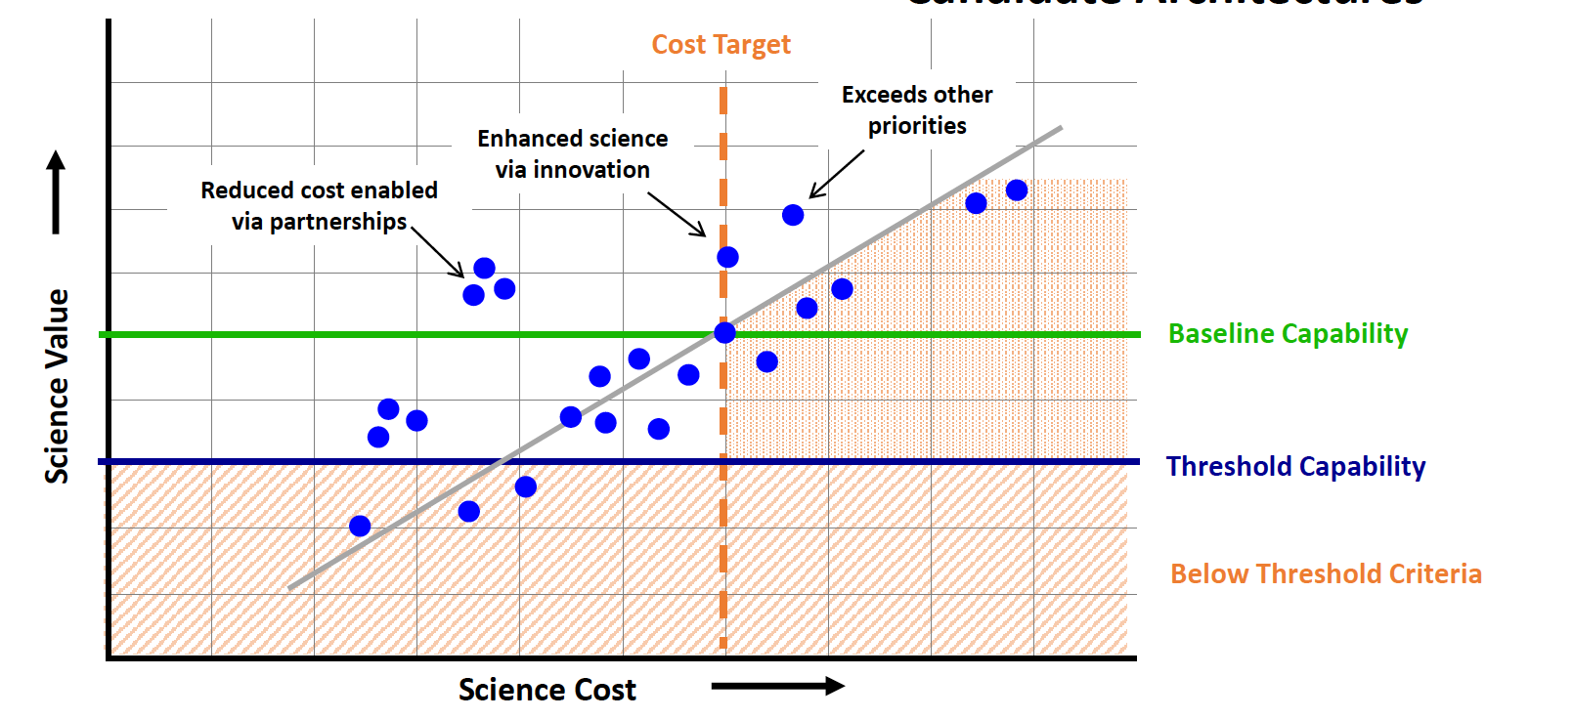
Architecture Assessment
Scoring of individual architectures based on science value (i.e., meeting capabilities in SATM, OSSEs etc.), cost ($650M constraint), risk (e.g., TRL)

Slide 14
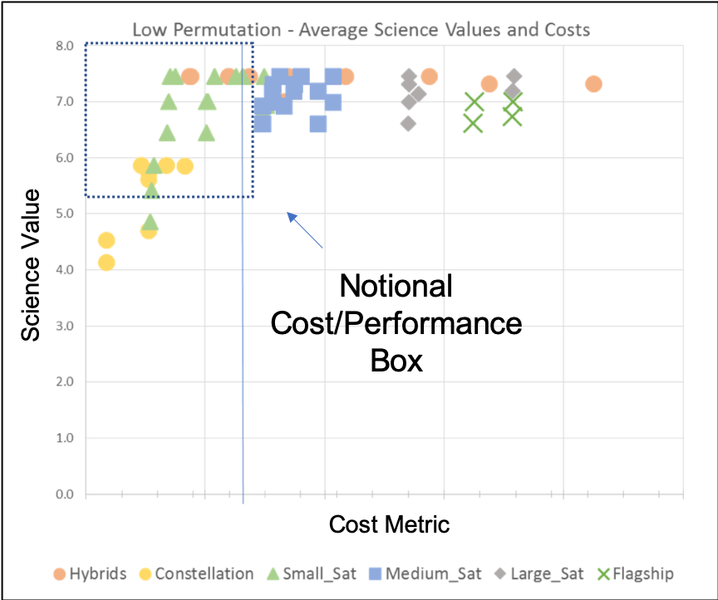
Example of Preliminary Assessment
Rules for defining the cost and performance boundaries will be established in Phase 2

Slide 15
Ongoing Phase II Activities
Application of the value framework metrics
Performing the TeamX and design center studies (cost, risk and science estimation)
Refining the cost/value of adding additional features to feasible architectures (e.g. low data latency)
Further exploring the synergy with ACCP for orbital configurations and physical architectures
Studying the sub-orbital contributions to the architecture (UAV)
Applying appropriate programmatic risk metric(s)

Slide 16
Summary and Conclusions
Instrument architectures identified based on instrument modeling, RFI responses, program of record and available technologies
Trade space spans the mission class, platform, number of platforms, instrument configuration, calibration approach, data latency, etc.
Phase I identified potential options based on instrument model and trade space
Phase II performs mission-level designs on feasible options to characterize to 1-3 options
Phase II identifies the promising options after detailed modeling and design study and provides them to HQ with supporting information

Slide 17
Backups

Slide 18
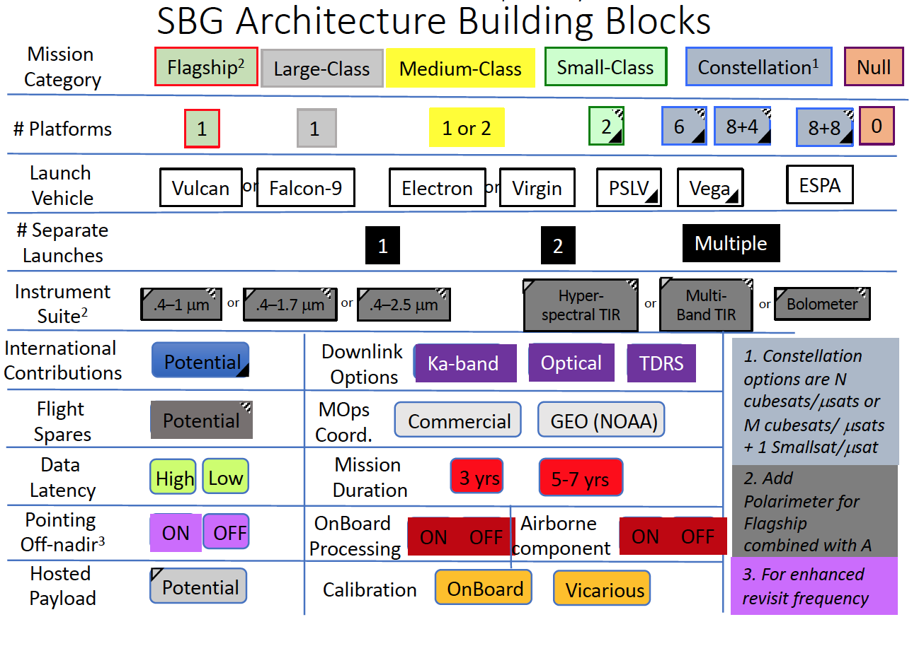
Architecture Formulation Approach
Notes:
ATEAM/RFI to TEAM-X to IDL to MDL to MCR

Slide 19
Concept of Operations
SBG has 9 core geophysical data products
Plant traits Spectral performance
Evapotranspiration Temperature versus emissivity, frequency
Minerals Spectral performance
Vegetation cover spectral performance
Aquatic classification Spectral performance
Aquatic biology Spectral performance, frequency
Snow Frequency
Fire Frequency, 4 micron dynamic range
Volcanic gases Frequency
Natural Hazards Frequency
Mow the
lawn
+ Event-Driven

Slide 20
Observing System Classes
FLAGSHIP SATELLITE ($220 - 240M)
SMALL SATELLITE
S/C Mass Range 100-300 kg
Volume
~0.8x0.8x0.6 m³
($30 - 35M)
"ite
DC Power
100-300 W
Constellation Size
2-4
S/C Mass Range
2000-2500 kg
DC Power
1000-1800 W
Constellation Size
1
Payload Mass
Payload Mass
800-1000 kg
Instrument Performance
Excellent
40-120 kg
Instrument Performance
Good
Payload Volume
~4x2x2 m³
A flagship spacecraft in the vein of AURA, AQUA, or TERRA. Has a wide suite of instru- ment modes for observation. Instrument suite addresses multiple DOs. Compatible with
the larger class of launch Vehicle, e.g. Falcon-9, Vulcan. Platform accommodates both VSWIR and TIR instruments with generous margins. 5-7 year lifetimes.
Spacecraft on the order of Ball's BCP-100 or smaller versions of the NGIS LeoStar-2, or the OneWeb bus from AirBus. Compatible with smaller launch vehicles such as Electron, Pegasus,
Virgin Orbit. ESPA-ring compatible up to 180 kg. ESPA-ring Grande compatible at 180-300 kg mass range. Only one instrument per platform. Volume constraints may impose some compromise on instrument performance, e.g. swath coverage or spatial resolution. 3-yr. lifetimes.
LARGE SATELLITE ($220 - 240M)
MICROSAT ($9 - 10M)
S/C Mass Range
30-125 kg
Payload Volume
~0.6x0.6x0.8 m³
S/C Mass Range
1000-2000 kg
Payload Volume
~3x1.5x1.5 m³
DC Power
500-1500 W
Constellation Size
Payload Mass
DC Power
30-125 W
Constellation Size
Payload Mass
400-600 kg
Instrument Performance
Very Good
12-40 kg
Instrument Performance
Moderate
1
Up to 6
Spacecraft on the scale of LANDSAT-7 or LANDSAT-8. Platform carries both VSWIR and TIR instruments. Compatible with the larger class of launch Vehicle, e.g. Falcon-9, Vulcan. Platform easily accommodates both VSWIR and TIR instruments. 5-7 year lifetimes.
Larger than a 12U. Typical example is SkyBox from SSL.. ESPA-ring compatible. Smaller dimensions available for payload mean each satellite can only provide fractional capability, e.g. reduced swath, coarser spatial resolution, or reduced spectral range, or number of bands.
Compatible with smaller launch vehicles such as Electron, Pegasus, Virgin Orbit. 3-yr. lifetimes.
MEDIUM SATELLITE ($94 - 108M)
CUBESAT ($4 - 6M)
S/C Mass Range
S/C Mass Range
500-1000 kg
Payload Volume
~1.75x1x1 m³
DC Power
200-700 W
Constellation Size
Payload Mass
200-400 kg
Instrument Performance
Very Good
DC Power
10-120 W
Constellation Size
Payload Mass
5-20 kg
2-14 kg
Payload
Volume
~0.2x0.2x0.3 m³
Instrument Performance
1-2
4-30 Fair
Spacecraft on the scale of the LeoSTAR-2 bus flown on OCO-2 or Ball's BCP 2000 spacecraft used for Icesat. Platform may carry both VSWIR and TIR instruments, or use separate platforms. 5-7 year lifetimes.
3U to 12U cubesat platforms, available as product lines from multiple vendors for LEO. Small dimensions available for payload mean each satellite can only provide fractional capability, e.g. reduced swath, coarser spatial resolution, or reduced spectral range, or number of bands.
Compatible with standardized P-Pod launch adapters with many options for flight as secondary payloads. Up to 3-yr. lifetimes.

